Slide 1
Anishinaabe and Haudenosaunee Clan Systems
Systems of governance
ElbowLakeCentre.ca © Queen’s University Biological Station (QUBS), 2023

Slide 2
Please Note:
What is shared in this slide show represent an Indigenous perspective, however, Indigenous peoples local to this territory may hold different Clan teachings and understandings. This reflects the fact that Indigenous ways of knowing and being are diverse and reminds us of the dangers of pan-Indigenizing.
ElbowLakeCentre.ca © Queen’s University Biological Station (QUBS), 2023
Notes:
2

Slide 3
Clan Systems
Within the Clan System, animals are teachers. Animals offer guidance to humans on how to conduct oneself in a good way.
ElbowLakeCentre.ca © Queen’s University Biological Station (QUBS), 2023
Notes:
3

Slide 4
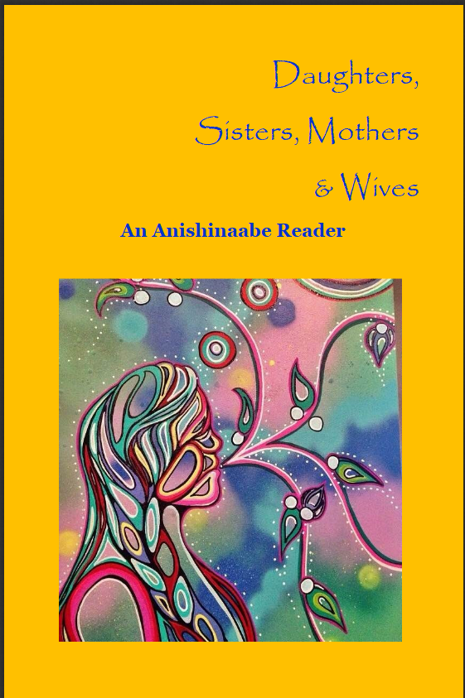
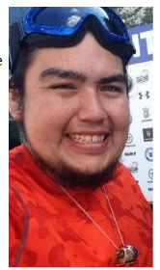
Anishinaabe Clan System
Descriptions of Anishinaabe Clans can be found in Daughters, Sisters, Mothers and Wives An Anishinaabe Reader
Author Brennor Jacobs, Turtle Clan of the Oneida Nation, has compiled these descriptions from Anishinaabe Knowledge Holders.
Translated by Amanda Aikens (Ojibwa-Potawatomi of the Midewiwin Lodge), Wahbzii Shognosh-Myers (Ojibwa-Potawatomi Bear Clan), Kyla Stonefish (Ojibwa-Potawatomi Sucker Fish Clan)
Brennor Jacobs, Turtle Clan of the Oneida Nation, Communications Major at Brock University, Ontario Native Literacy Coalition
ElbowLakeCentre.ca © Queen’s University Biological Station (QUBS), 2023
Notes:
Jacobs, B. (n.d.). Daughters, Sisters, Mothers & Wives: An Anishinaabe Reader. Ontario Native Literacy Coalition.
19

Slide 5
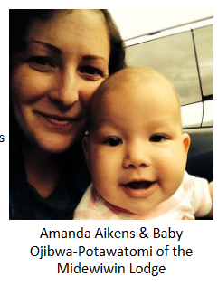
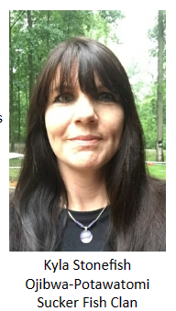
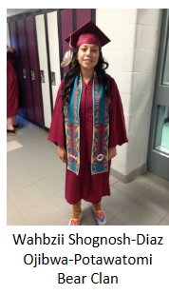
Anishinaabe Knowledge Contributors
ElbowLakeCentre.ca © Queen’s University Biological Station (QUBS), 2023
Notes:
Jacobs, B. (n.d.). Daughters, Sisters, Mothers & Wives: An Anishinaabe Reader. Ontario Native Literacy Coalition.
19

Slide 6
Anishinaabe Clan System
“The clan system is very important to us. In our culture, we have seven clans that make up our traditional governance system, and those clans are all born with different traits and attitudes that can be applied to modern jobs such as policing and social work."- Amanda Aikens, Daughters, Sisters, Mothers and Wives An Anishinaabe Reader, (Jacobs, 2015)
”
ElbowLakeCentre.ca © Queen’s University Biological Station (QUBS), 2023
Notes:
Jacobs, B. (2015). Daughters, Sisters, Mothers & Wives: An Anishinaabe Reader. Ontario Native Literacy Coalition.
19

Slide 7
Anishinaabe Clan System
HOW THE CREATOR INITIATED THE CLAN SYSTEM:
very important to the Anishinaabe
clans were initiated by the Creator
each clan has a different duty and responsibility
each clan is equal
The Creator convinced the animals to teach humans how to live in balance and harmony on the earth. The animals also teach the humans how to govern themselves with equitable social and political structures.
Odoodemiwaan- "their clans"
ElbowLakeCentre.ca © Queen’s University Biological Station (QUBS), 2023
Notes:
4

Slide 8
The Seven Original Odoodemiwaan
Ajijaak Dodem
Maang Dodem
Loon clan
Crane clan
Makwa Dodem
Waabizheshi Dodem
Giigoonh Dodem
Bear clan
Martin clan
Fish clan
Wawaashkeshi Dodem
Bineshiinh Dodem
Deer clan
Bird clan
ElbowLakeCentre.ca © Queen’s University Biological Station (QUBS), 2023

Slide 9
Ajijaak Dodem
Leadership- External Relations
Crane Clan
Responsible for negotiations and communicating with people from other communities.
Help to put new ideas into action.
Viewed as intelligent.
Use their knowledge of the teachings to make decisions for their community.
Focuses on Nation-to-Nation relations.
ElbowLakeCentre.ca © Queen’s University Biological Station (QUBS), 2023
Notes:
https://onlc.ca/wp-content/uploads/2017/05/An-Anishinaabe-Reader.pdf
Information for the Following Anishinaabe Clans Descriptions:
Jacobs, B. (n.d.). Daughters, Sisters, Mothers & Wives: An Anishinaabe Reader. Ontario Native Literacy Coalition.
Jacobson, M. A. (2012). Ojibway Clans: Animal Totems and Spirits. Native Northwest.
Mishibinijima, J. (2005). Ojibwe Clans. (M. Corbiere & E. Roy, Trans., L. Joly & B. Depencier, Eds.). Kenjigewin Teg Educational Institute.
6

Slide 10
Maang Dodem
Leadership-Internal Relations
Loon Clan
Responsible for settling disputes within the community.
Local leadership roles.
Members of the Loon Clan are often peacemakers.
The Crane and Loon Clans (the two leadership clans) represent balance
ElbowLakeCentre.ca © Queen’s University Biological Station (QUBS), 2023
Notes:
7

Slide 11
Giigoonh Dodem
Mediators
Fish Clan
Gifted mediators, planners, and thinkers.
Fish Clan people are intellectual and have the strength of resolving differences of opinions.
Politicians would ask members of the Fish Clan for advice and guidance on how to settle disputes.
ElbowLakeCentre.ca © Queen’s University Biological Station (QUBS), 2023
Notes:
8

Slide 12
Makwa Dodem
Healers
Bear Clan
Play a role in the health and security of the community.
Bear clan members are thoroughly knowledgeable about plants, berries, roots, and bark medicines (Jacobson, 2012).
Known as the medicine people.
ElbowLakeCentre.ca © Queen’s University Biological Station (QUBS), 2023
Notes:
Ojibway Clans [Animal Totems and Spirits] Mark Anthony Jacobson
9

Slide 13
Waabizheshi Dodem
Providers and Protectors
Marten Clan
Members of the Marten Clan are expert hunters and protectors.
They are knowledgeable and skilled in tracking their food as well as their enemies.
Responsibilities for economic development and planning defense strategies for their community.
Adopt people who do not know which clan they belong to.
ElbowLakeCentre.ca © Queen’s University Biological Station (QUBS), 2023
Notes:
10

Slide 14
Well-Being
Wawaashkeshi Dodem
Deer Clan
This clan represents the “gentle people”.
Deer Clan members preserved sacred teachings.
Concerned with the well-being of the community and healing the attitudes of others.
Ceremonies, celebrations, and other social aspects are the responsibility of the Deer Clan.
ElbowLakeCentre.ca © Queen’s University Biological Station (QUBS), 2023

Slide 15
Bineshiinh Dodem
Spiritual and Knowledge Leaders
Bird Clan
Members of the Bird Clan are Knowledge Keepers.
They have responsibilities for teaching others and expanding the community’s knowledge.
Birds are the closest animal to the Creator and are understood to be able to bring wisdom from the sky down to earth.
ElbowLakeCentre.ca © Queen’s University Biological Station (QUBS), 2023
Notes:
Jacobs, B. (n.d.). Daughters, Sisters, Mothers & Wives: An Anishinaabe Reader. Ontario Native Literacy Coalition.
https://onlc.ca/wp-content/uploads/2017/05/An-Anishinaabe-Reader.pdf
12

Slide 16
Haudenosaunee Clan System
Descriptions of Haudenosaunee Clans comes from Author Tom Porter, And Grandma Said…Iroquois Teachings as passed down through the oral tradition
Tom Porter, a Bear Clan Elder, has compiled these descriptions of the 9 Haudenosaunee clans through listening to many Elders speak about the Clans.
Tom Porter, Bear Clan Elder, Akwesasne Mohawk Nation
ElbowLakeCentre.ca © Queen’s University Biological Station (QUBS), 2023
Notes:
https://www.haudenosauneeconfederacy.com/clan-system/
Porter, T. (2008). And Grandma Said-- Iroquois Teachings as passed down through the oral tradition. (L. Forrester, Ed.). Xlibris Corp.
19

Slide 17
Haudenosaunee Clan System
Clan mothers head each clan.
In the past, the oldest woman of the clan was recognized as the clan leader.
Today, clan mothers are chosen for their cultural wisdom and dedication to their people.
It is said that Ro’nikonhrowá:nen ("he who has good ideas") introduced the Haudenosaunee to the clan system during a time of great population growth
Clan system was revitalized by the Peace Maker
Haudenosaunee clans are matrilineal
(inherited from mothers)
Clans are named after various animals
Provides guidance on how to conduct oneself spiritually, socially, economically, and politically
ElbowLakeCentre.ca © Queen’s University Biological Station (QUBS), 2023
Notes:
16

Slide 18
Haudenosaunee Clan System
Ro’nikonhrowá:nen provided the Haudenosaunee with two moieties (groupings) of clans.
The First Grouping:
The Second Grouping:
Rotinyahton (Turtle Clan)
Ronathahyón:ni (Wolf Clan)
Tsyani’to (Beaver Clan)
Kahrhakón:ha Teyakoia’tàhkhwa
(Hawk Clan)
Rotiskaré:wake (Bear Clan)
Roti’nehsí:yo (Snipe Clan)
Rotinenyo’thró:non (Deer Clan)
Tyawerón:ko (Eel Clan)
ElbowLakeCentre.ca © Queen’s University Biological Station (QUBS), 2023
Notes:
17

Slide 19
Haudenosaunee Clan System
Each member of a specific clan are considered relatives, even if they are from different nations
The number of clans will vary, depending on each nation:
Mohawk has 3 clans
Oneida has 3 clans
Onondaga has 9 clans
Cayuga has 5 clans
Seneca has 8 clans
Tuscarora has 7 clans
(Nations are listed from East to West, following the direction that the sun rises and sets.)
ElbowLakeCentre.ca © Queen’s University Biological Station (QUBS), 2023
Notes:
https://www.haudenosauneeconfederacy.com/clan-system/
https://oneidalanguage.ca/oneida-culture/oneidalanguage-clans/
https://oneida-nsn.gov/our-ways/our-story/clan-systems/
https://www.onondaganation.org/culture/
https://cayuganation-nsn.gov/index.html
https://www.britannica.com/topic/Seneca-people
Image from: https://www.haudenosauneeconfederacy.com
18

Slide 20
Rotiskaré:wake
Bear Clan
Bear Clan people are very sensitive to others and somewhat quiet.
Members of the Bear Clan are very knowledgeable about medicines and are known as healers.
They have a diplomatic nature and tend to stay away from trouble.
Bear Clan people are often known to hold grudges and they will not forget when they have been hurt or mistreated.
ElbowLakeCentre.ca © Queen’s University Biological Station (QUBS), 2023
Notes:
https://www.montrealcentreville.ca/en/activities/discover-the-origins-of-the-rotinonhsionni-clan-system/
20

Slide 21
Snipe Clan
Roti’nehsí:yo
Members of the Snipe Clan often keep themselves busy and are usually working on something.
Snipe Clan tend to be positive people and have lots of energy.
Snipe Clan people do not hesitate to help others with projects, and they will put their whole heart into what they are involved in.
ElbowLakeCentre.ca © Queen’s University Biological Station (QUBS), 2023
Notes:
21

Slide 22
Rotinenyo’thró
Deer Clan
Originally from the Onondaga or the Cayuga nations.
Members of the Deer Clan are generally timid/shy and tend to take on the role of followers instead of leaders.
Deer Clan people are kind-hearted and sensitive.
ElbowLakeCentre.ca © Queen’s University Biological Station (QUBS), 2023
Notes:
22

Slide 23
Eel Clan
Tyawerón:ko
The Eel Clan is of the water.
Eel clan members are caring with a special relationship to the water.
Eel clan members are thought to be caring, respectful, and conscientious advocates.
ElbowLakeCentre.ca © Queen’s University Biological Station (QUBS), 2023
Notes:
23

Slide 24
Rotinyahton
Turtle Clan
The turtle is a symbol of the earth.
We live on Turtle Island (North America) and walk on the turtle’s back.
Members of the Turtle Clan are consistent, determined, and usually very shy.
Turtle Clan people tend to have characteristics that are between Wolf and Bear Clan.
ElbowLakeCentre.ca © Queen’s University Biological Station (QUBS), 2023
Notes:
24

Slide 25
Wolf Clan
Ronathahyón:ni
Members of the Wolf Clan are honest and straight forward.
These people are thought to have diplomatic characteristics and will easily say what is on their minds.
Wolf Clan people are hard workers and seek out evidence and truth.
“The Wolf Clan people seem not to believe what is told to them at first. They always cross-examine, but once satisfied, they are workers and believers” (Porter, 2008).
ElbowLakeCentre.ca © Queen’s University Biological Station (QUBS), 2023
Notes:
25

Slide 26
Tsyani’to
Beaver Clan
The Beaver clan is of the water.
Beaver clan members are thought to be hardworking, persevering, industrious, artistic, self-sufficient, creative and, patient.
ElbowLakeCentre.ca © Queen’s University Biological Station (QUBS), 2023
Notes:
26

Slide 27
Hawk Clan
Kahrhakón:ha Teyakoia’tàhkhwa
The Hawk Clan is a clan of the air.
Like eagles, hawks represent courage and strength.
Hawk clan members are thought to be brave and able to handle life's challenges.
ElbowLakeCentre.ca © Queen’s University Biological Station (QUBS), 2023
Notes:
27

Slide 28
Rotihshennakéhte
They Carry the Name
The Rotihshennakéhte were born without a Clan.
“Many years ago, when our people were attacked and killed, our ancestors would go to the place where they lost people and capture women, men, and children to replace them. These captives…were adopted and married into the Mohawks. They and their offspring were, and still are, called the people of the Rotihshennakéhte” (Porter, 2008).
ElbowLakeCentre.ca © Queen’s University Biological Station (QUBS), 2023

Slide 29
References
​
Discover the origins of the Rotinonhsión:ni clan system | Montréal centre-Ville (montrealcentreville.ca)
Jacobs, B. (2015). Daughters, Sisters, Mothers & Wives: An Anishinaabe Reader. Ontario Native Literacy Coalition.
Porter, T. (2008). And Grandma Said-- Iroquois Teachings as passed down through the oral tradition. (L. Forrester, Ed.). Xlibris Corp.
https://www.haudenosauneeconfederacy.com/clan-system/
ElbowLakeCentre.ca © Queen’s University Biological Station (QUBS), 2023
Notes:
https://archaeologymuseum.ca/shop/?product=raymond-skye-hawk-clan
27

