Slide 1
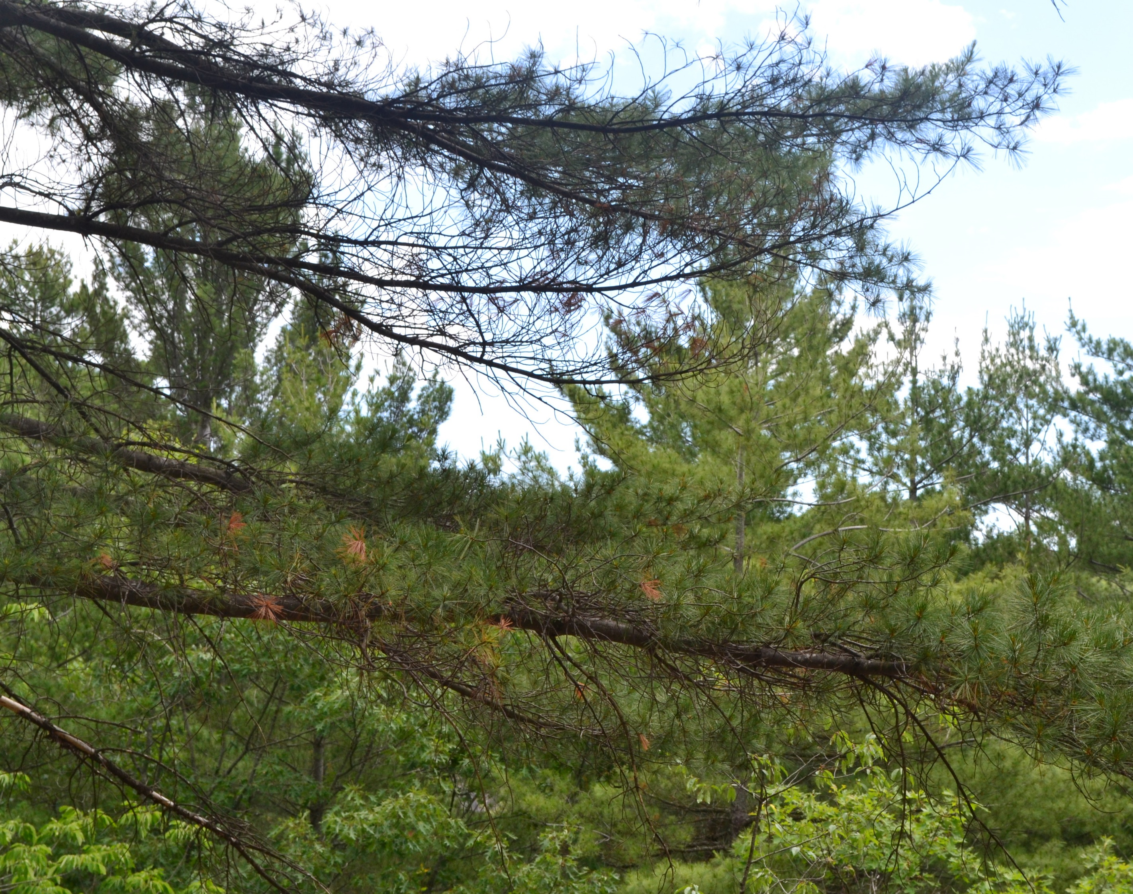
Aanii! Shé:kon! Welcome!
ElbowLakeCentre.ca © Queen’s University Biological Station (QUBS), 2023
Notes:
welcome statement

Slide 2
Importance of Land Acknowledgements
More than a Checked Box!
ElbowLakeCentre.ca © Queen’s University Biological Station (QUBS), 2023
Notes:
Chances are, you’ve seen or heard a land acknowledgement at some point in the past few years. But maybe you don’t totally understand why land acknowledgements are so important.
They are not about placing blame.
Land acknowledgments are about our collective connection to and relationship with the land. Indigenous people’s connection to the land is sacred and foundational to their ways of knowing and being and the land acknowledgement is a way of reminding everyone of this. Historically, when communities would come together to a particular area, the visitors would acknowledge the inhabitants/keepers of the land. It was to show respect.
So, the land acknowledgement is also about showing respect for the traditional keepers of the land – the original Indigenous inhabitants. It is a way of recognizing inherent rights to the land that First Peoples hold. It is also a way of recognizing the injustices that have been carried out against Indigenous communities historically, for example, through broken treaty relationships, residential schools, the Sixties Scoop.
Acknowledgement of the traditional territory upon which we all live is an important step toward reconciliation. It is one of the recommendations or “calls for action” put forward by the Truth and Reconciliation Commission of Canada to help restore a balanced relationship between Indigenous peoples and settler communities.
Unfortunately, in recent years land acknowledgements have come to commonly be recited at the beginning of events with little thought to their intended purpose. When used in this manner land acknowledgements can appear as a box to check as opposed to a meaningful statement reminding Canadians of their collective relationship to one another and with the land. It is important that when land acknowledgements are used, they are utilized in a meaningful way reflecting the relationship the individual who is delivering the acknowledgement has to the traditional territory and its original inhabitants. This can be done by reflecting on and stating what they are doing not only to live as allies working towards reconciliation but also to live in reciprocity with the land, protecting it for the next 7 Generations. An important takeaway is that colonization severely eroded the relationship of reciprocity Indigenous communities enjoyed with the natural world. Restoring this relationship of reciprocity for all Canadians, accordingly, is a powerful act of reconciliation and decolonization.

Slide 3
Coming Together to Do the Heart Work
Land use by Indigenous peoples prior to European contact.
Land use as it changed with European contact.
Treaties that influence us.
ElbowLakeCentre.ca © Queen’s University Biological Station (QUBS), 2023
Notes:
To Begin we need to take a journey. Looking at today and going back to pre contact. Some of this will be new information as we share here. If you have questions raise your hand or put them in the chat. Heart Work is the work done within a self-reflection element and an individual positionality to create a Land Acknowledgement.

Slide 4
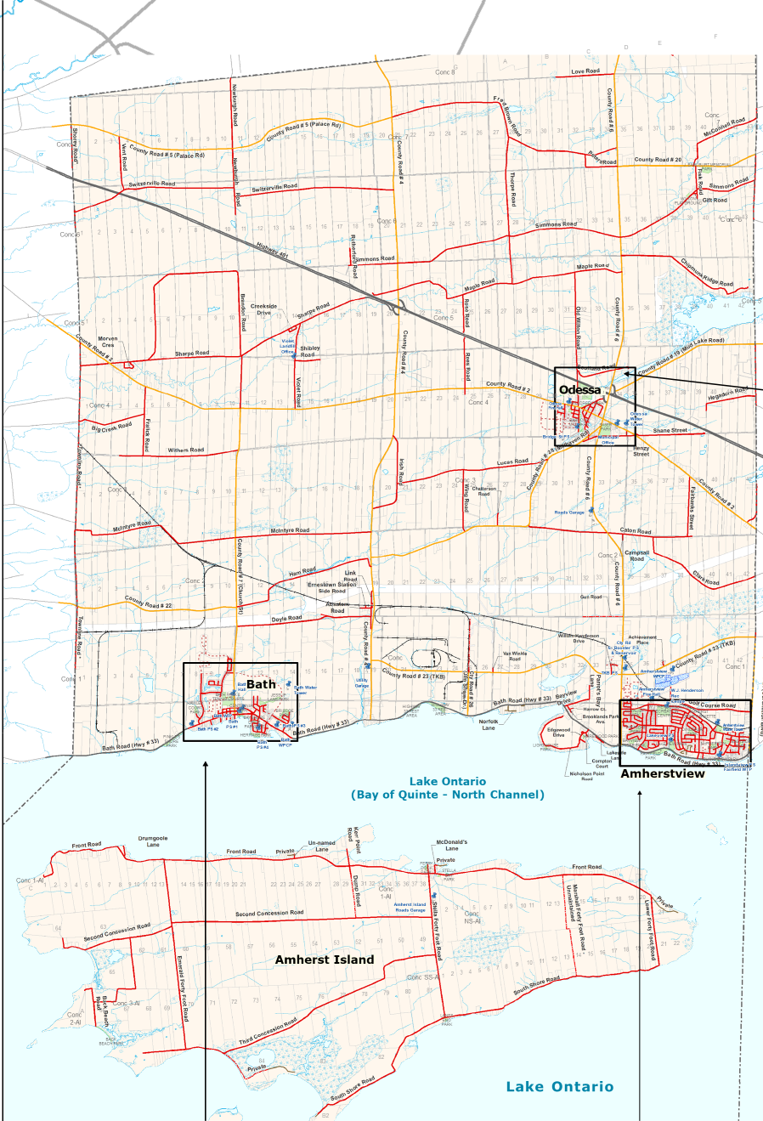
Choose a map that reflects your area.
School Board Boundaries Include:
Lake Ontario, Bay of Quinte- North Channel
Amherst Island
County Road 24/ Coronation Boulevard
Wilson Road
Sherey Road
ElbowLakeCentre.ca © Queen’s University Biological Station (QUBS), 2023

Slide 5
ElbowLakeCentre.ca © Queen’s University Biological Station (QUBS), 2023
Notes:
Wampum Treaties – Dish with One Spoon and Two Row Wampum

Slide 6
ElbowLakeCentre.ca © Queen’s University Biological Station (QUBS), 2023
Notes:
Contact Treaties that influence us are Crawford’s Purchases 1783, Treaty 3 1/2 (Mohawks of the Bay of Quinte – Tyendenaga Territory. The Algonquin Nations were pushed out of their lands by the Mississaugans, Many moved to reserves, however ,there were some that held onto their land tenaciously. Chief Joseph Whiteduck of Ardoch and Chief Shabot of Sharbot Lake.
By October of 1783, Captain William Crawford, formerly of the Royal Regiment of New York, acted on behalf of the British Government and reported his success: The elderly
Chief Mynass of the Mississauga had been summoned to Carleton Island, where he (and company – other Onandaga Chiefs) agreed to sell their land. The precise extent of the territory referred to by the agreement was vague. While Crawford claimed that it spanned from the Toniata or Onagara River (a tributary of the St. Lawrence, below Gananoque) to a river in the Bay of Quinte, including the islands, the Mississaugas recollection of the terms was that they had surrendered their rights to an area determined by how far the sound of a gunshot carried.
Wampums – Two Row Wampum

Slide 7
Examples of a Land Acknowledgement
What is the same?
What is different?
What language tense is being used past, present, future?
ElbowLakeCentre.ca © Queen’s University Biological Station (QUBS), 2023
Notes:
Land Acknowledgements need to be authentic, recognize the land accurately, including treaties and unceded territories, recognize past harms done to Indigenous peoples, include current Indigenous peoples living in the area, and have a plan to a path of reconciliation.

Slide 8
Words to Inspire us to Greater Heights
What words do we want to see in our Land Acknowledgement?
What words do we not want to see in our Land Acknowledgement?
Pronunciation of Indigenous Titles
ElbowLakeCentre.ca © Queen’s University Biological Station (QUBS), 2023
Notes:
Land acknowledgements should have all three tenses, past, present, and future included in your acknowledgement. Words are important, chose wisely. Honour the Indigenous people by pronouncing names and titles correctly.

Slide 9
Plan for Reconciliation
Include one short-term goal.
Include one long-term goal.
Include why this is important for you or your class.
ElbowLakeCentre.ca © Queen’s University Biological Station (QUBS), 2023
Notes:
Your plan for reconciliation should have one short-term goal that builds to your long-term goal. There are 94 calls to action, there are personal goals such as learning greetings or treaties all are relevant.

Slide 10
Putting it all Together
What is the purpose of this acknowledgement?
Whose land, is it? Treaties? Nearby Indigenous communities?
Past harms to Indigenous people.
Local Indigenous land knowledge.
ElbowLakeCentre.ca © Queen’s University Biological Station (QUBS), 2023
Notes:
Your plan for reconciliation should have one short-term goal that builds to your long-term goal. There are 94 calls to action, there are personal goals such as learning greetings or treaties all are relevant.

Slide 11
Putting it all Together
Include a pronunciation guide.
Current land use.
Practice, Review, and Revise.
Plans for reconciliation.
ElbowLakeCentre.ca © Queen’s University Biological Station (QUBS), 2023
Notes:
Your plan for reconciliation should have one short-term goal that builds to your long-term goal. There are 94 calls to action, there are personal goals such as learning greetings or treaties all are relevant.

Slide 12
Your Land Acknowledgement is Complete
It is a living document, never let it be a check in a box.
ElbowLakeCentre.ca © Queen’s University Biological Station (QUBS), 2023

