Slide 1
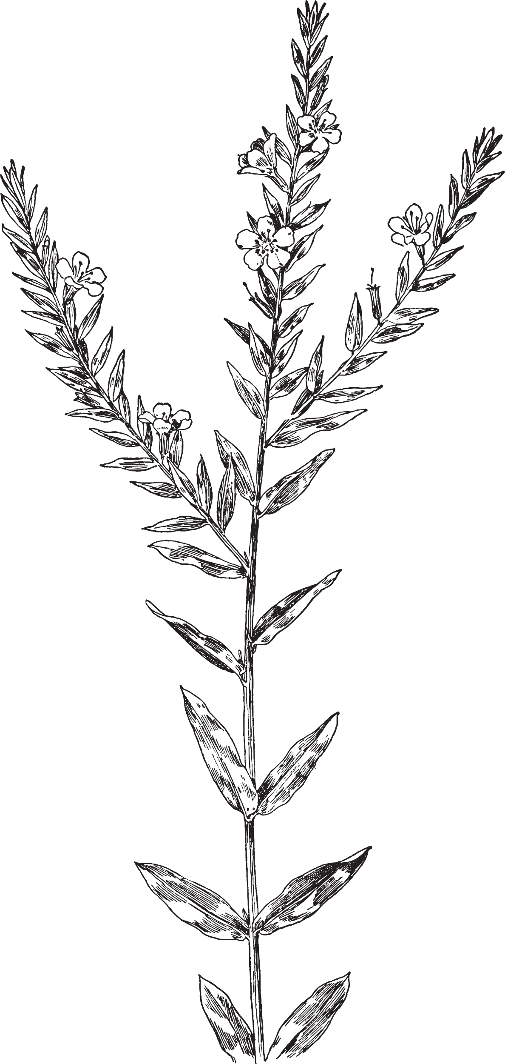
Invasive Species Impact on Ecosystems
ElbowLakeCentre.ca © Queen’s University Biological Station (QUBS), 2023

Slide 2
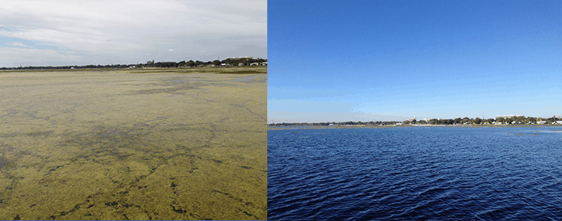
The Impact of Hydrilla
More oxygen and sunlight reaching aquatic wildlife
More efficient water movement and circulation
Less entanglement while swimming
Less mosquitoes
Balanced Ecosystem
With Hydrilla
Without Hydrilla
Image from Mark Heilman, found from https://www.greenhousemag.com/article/rise-promotes-integrated-approach-to-manage-invasive-species/
ElbowLakeCentre.ca © Queen’s University Biological Station (QUBS), 2023

Slide 3
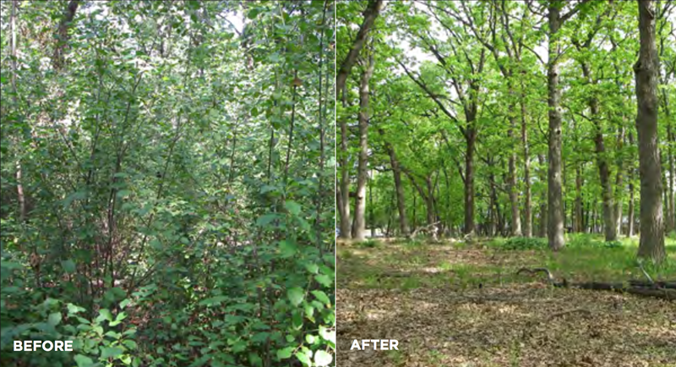
The Impact of Woody Invasive Species (including buckthorn and honeysuckle)
More sunlight reaches the ground, which allows for the growth of native seedlings and other vegetation/ground cover
Balanced soil ecosystem and nutrient cycling
Image from https://www.lcfpd.org/what-we-do/projects/woody-invasive-species-clearing-project/
ElbowLakeCentre.ca © Queen’s University Biological Station (QUBS), 2023

Slide 4
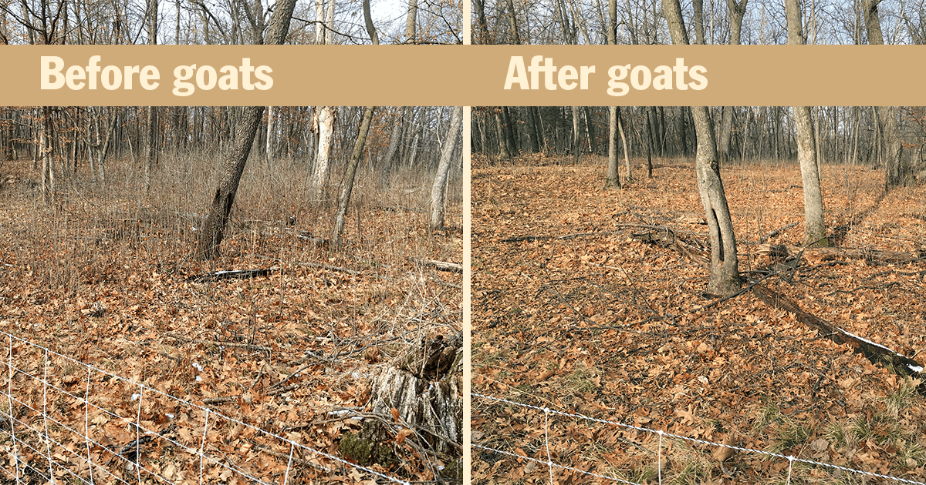
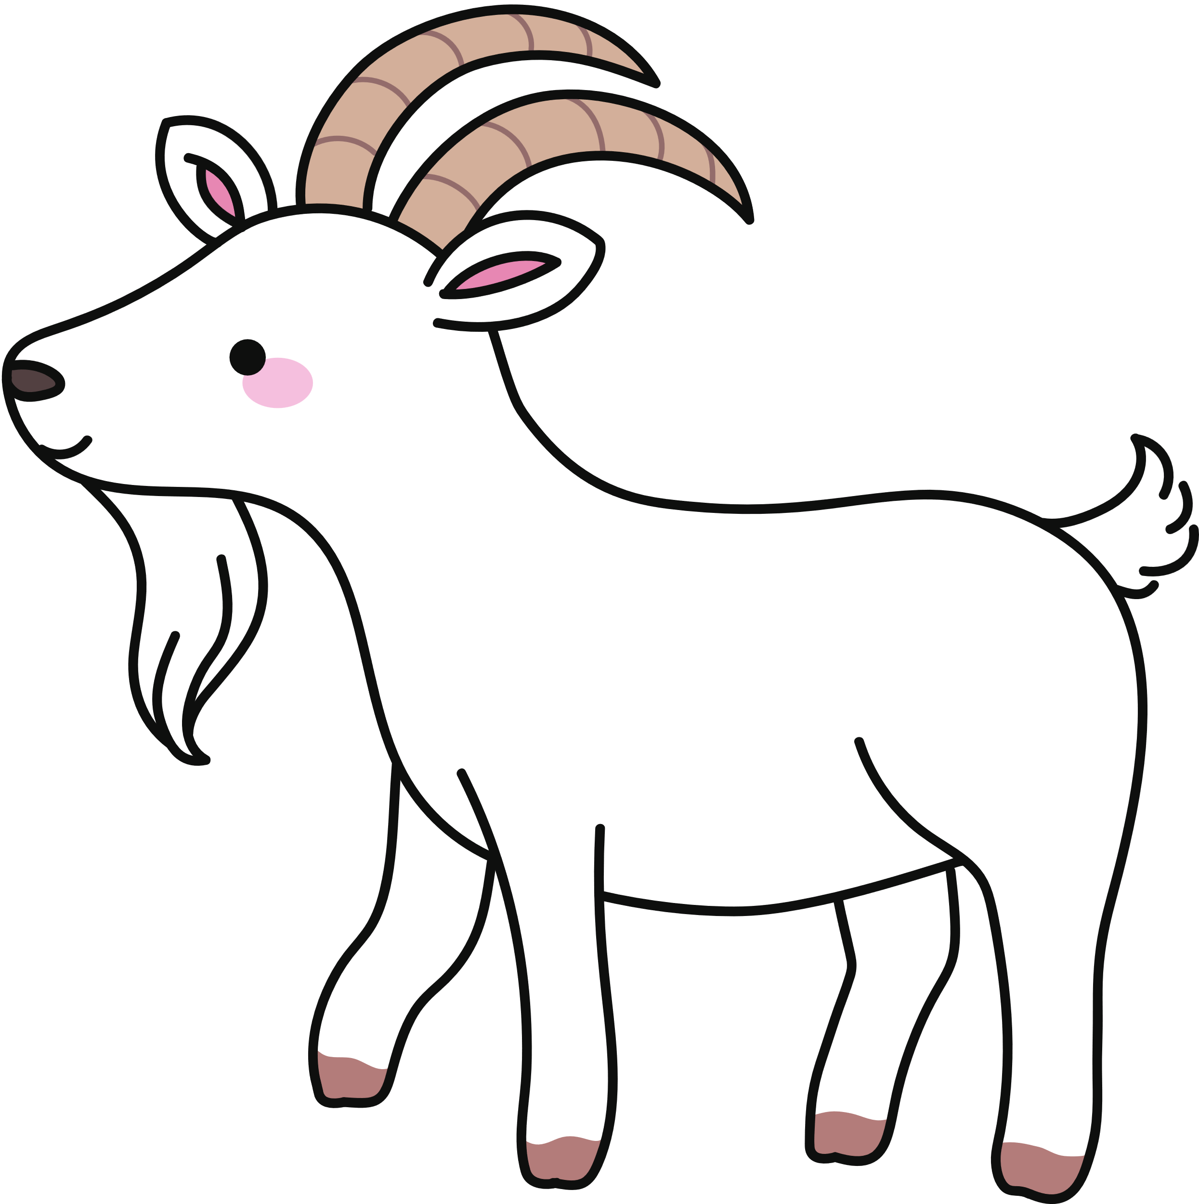
The Impact of Woody Invasive Species (buckthorn)
Using other species (ex. goats) to eradicate invasives is more sustainable
Less herbicide use
More sunlight reaching the ground for native seedlings
Balanced soil ecosystem and nutrient cycling
With Invasives
Without Invasives
Image from https://fmr.org/conservation-updates/invasives-got-your-goat-bucking-buckthorn-hampton-woods
ElbowLakeCentre.ca © Queen’s University Biological Station (QUBS), 2023

Slide 5
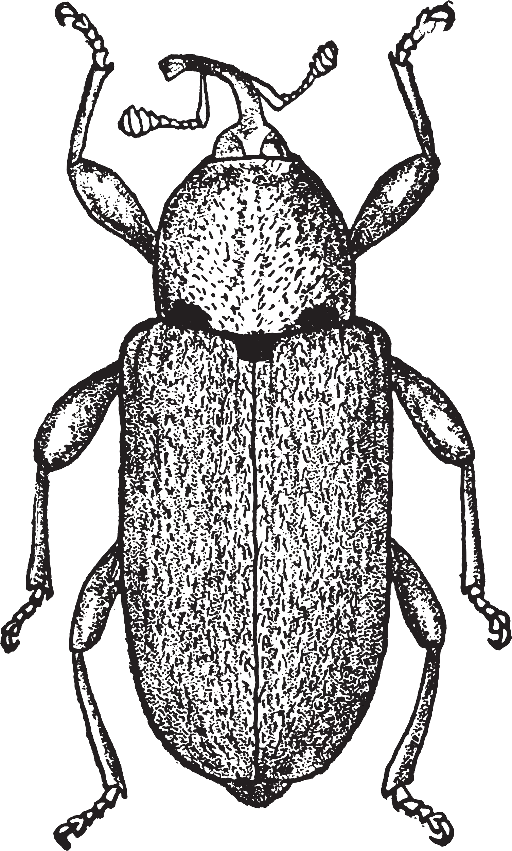
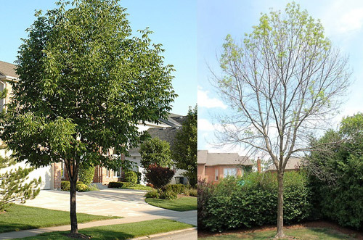
The Impact of the Emerald Ash Borer
Ash Trees provide protection of smaller vegetation in forests
Provides a home for many species (birds, insects, lichen, fungi)
Seeds are also a source of food
Supports biodiversity
Without
With
Image by Stephen Luk found from https://entnemdept.ufl.edu/creatures/TREES/BEETLES/emerald_ash_borer.htm
ElbowLakeCentre.ca © Queen’s University Biological Station (QUBS), 2023

Slide 6
The Impact of Purple Loosestrife
More space for native plants
(less crowding)
More food, nutrients and shelter for species in the ecosystem
More shallow water areas for fish
More efficient nutrient decomposition and cycling, leading to a balanced food web
With Purple Loosestrife
Without Purple Loosestrife
Image from Wilson, L., Schwarzlaender, M., Blossey, B., and Randall, C. B. (2004). Biology and biological control of purple loosestrife. USDA Forest Service/UNL Faculty Publications. https://www.researchgate.net/publication/228884676_Biology_and_Biological_Control_of_Purple_Loosestrife
ElbowLakeCentre.ca © Queen’s University Biological Station (QUBS), 2023

