Slide 1
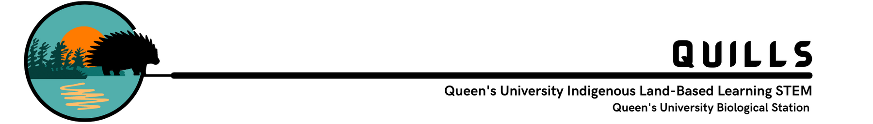
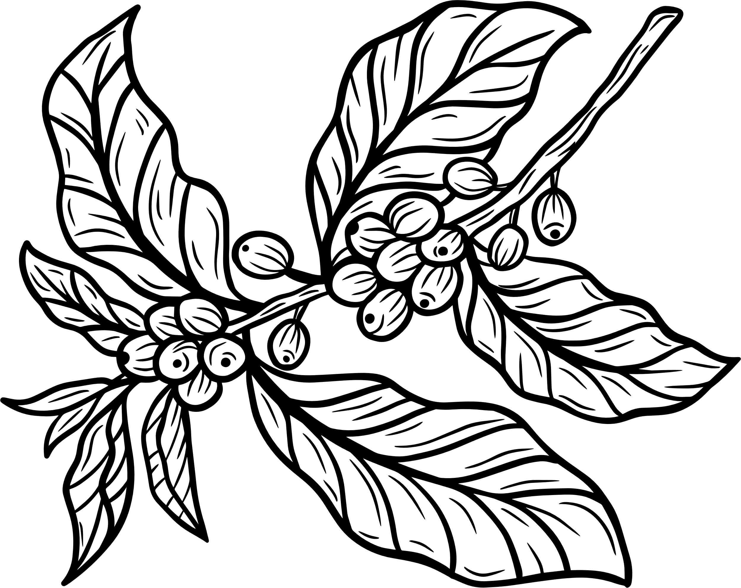




Engaging with Reciprocity and Interdependence
ElbowLakeCentre.ca © Queen’s University Biological Station (QUBS), 2023

Slide 2

This activity is inspired by a study conducted by local Queen's University Professors! We will explore their main findings, and attempt to complete a simplified version of it on our own classroom!
The citation for the study is: Serafini, J., Grogan, P., and Aarssen, L. 2019. Summer precipitation limits plant species richness but not overall productivity in a temperate mesic old‐field meadow. Journal of Vegetation Science. 30(5): 832–844.
ElbowLakeCentre.ca © Queen’s University Biological Station (QUBS), 2023

Slide 3

Summary of the Study:
Climate change is impacting the process of precipitation (rainfall), as it is increasing its variability, which means that rainfall is becoming more unpredictable. Some regions are experiencing increased rain over a year, while other regions are experiencing decreased amount of rain over a year.
ElbowLakeCentre.ca © Queen’s University Biological Station (QUBS), 2023

Slide 4

Summary of the Study:
Water from precipitation is an important factor that effects the growth of plants in terrestrial locations, especially in areas that don't rely on human intervention, such as man-made irrigation systems or watering. In the Great Lakes region, where we are located, it is predicted that rain in the summer is decreasing annually. Rain affects soil moisture, as well as species richness (which is the amount of different species in an area/ community). Human activity also impacts soil nutrients, as certain nutrients such as phosphorous and nitrogen will increase with fertilizer and other substances. Rainfall, soil moisture, species richness, and soil nutrients all affect plant growth, and thus plants exist in a very complex and interdependent system, where many factors depend on many other factors.
ElbowLakeCentre.ca © Queen’s University Biological Station (QUBS), 2023

Slide 5
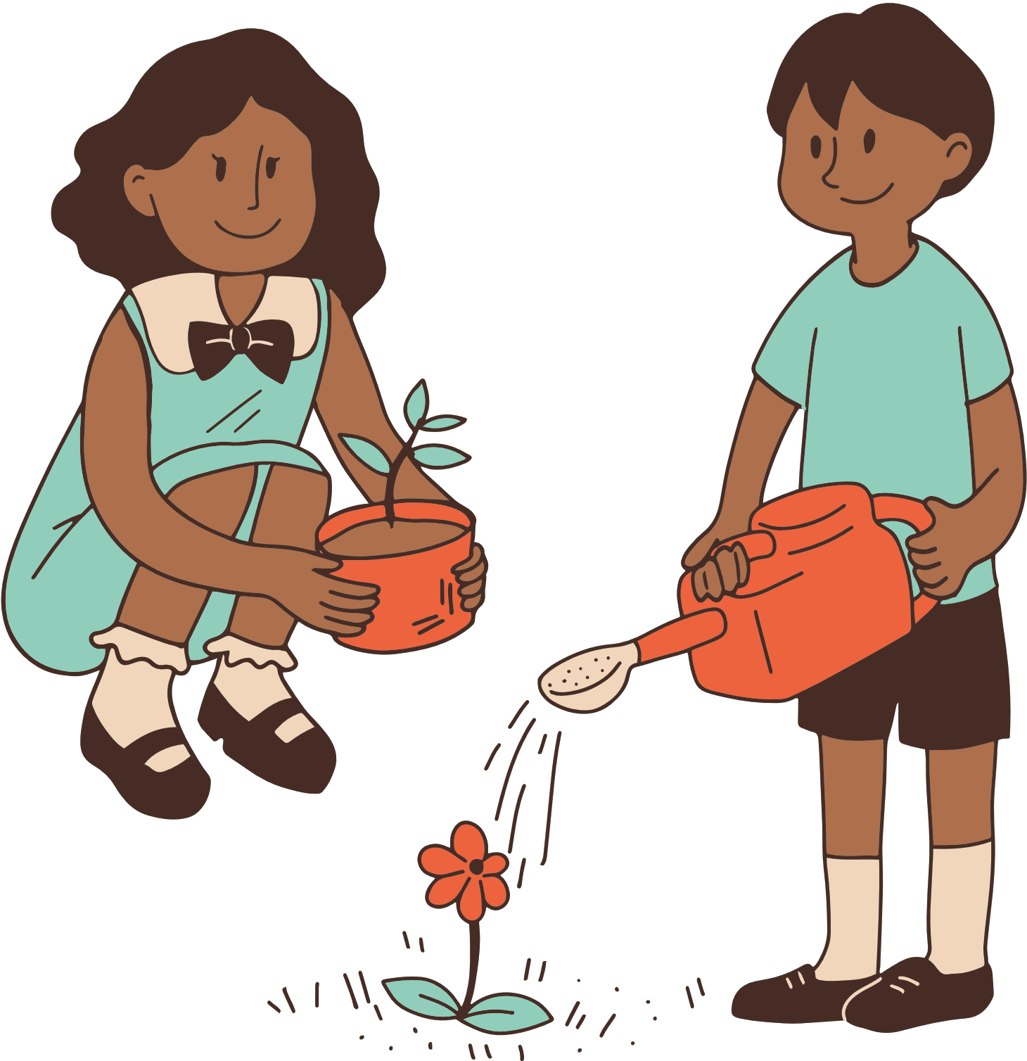
Summary of the Study:
The researchers experimented with many different factors, yet we will only focus on the rainfall. They were able to change the amount of rain plants received, through different rainfall "treatments." One treatment was called the water-reduced treatment, where they used rainout shelters to reduce the amount of rainfall the plants received. Another treatment was called the water-addition treatment, where they increased the amount the plants received through experimentation manipulations. Lastly, the control treatment is where they did not change the amount of rain the plants received, and they just used normal rainfall.
ElbowLakeCentre.ca © Queen’s University Biological Station (QUBS), 2023

Slide 6
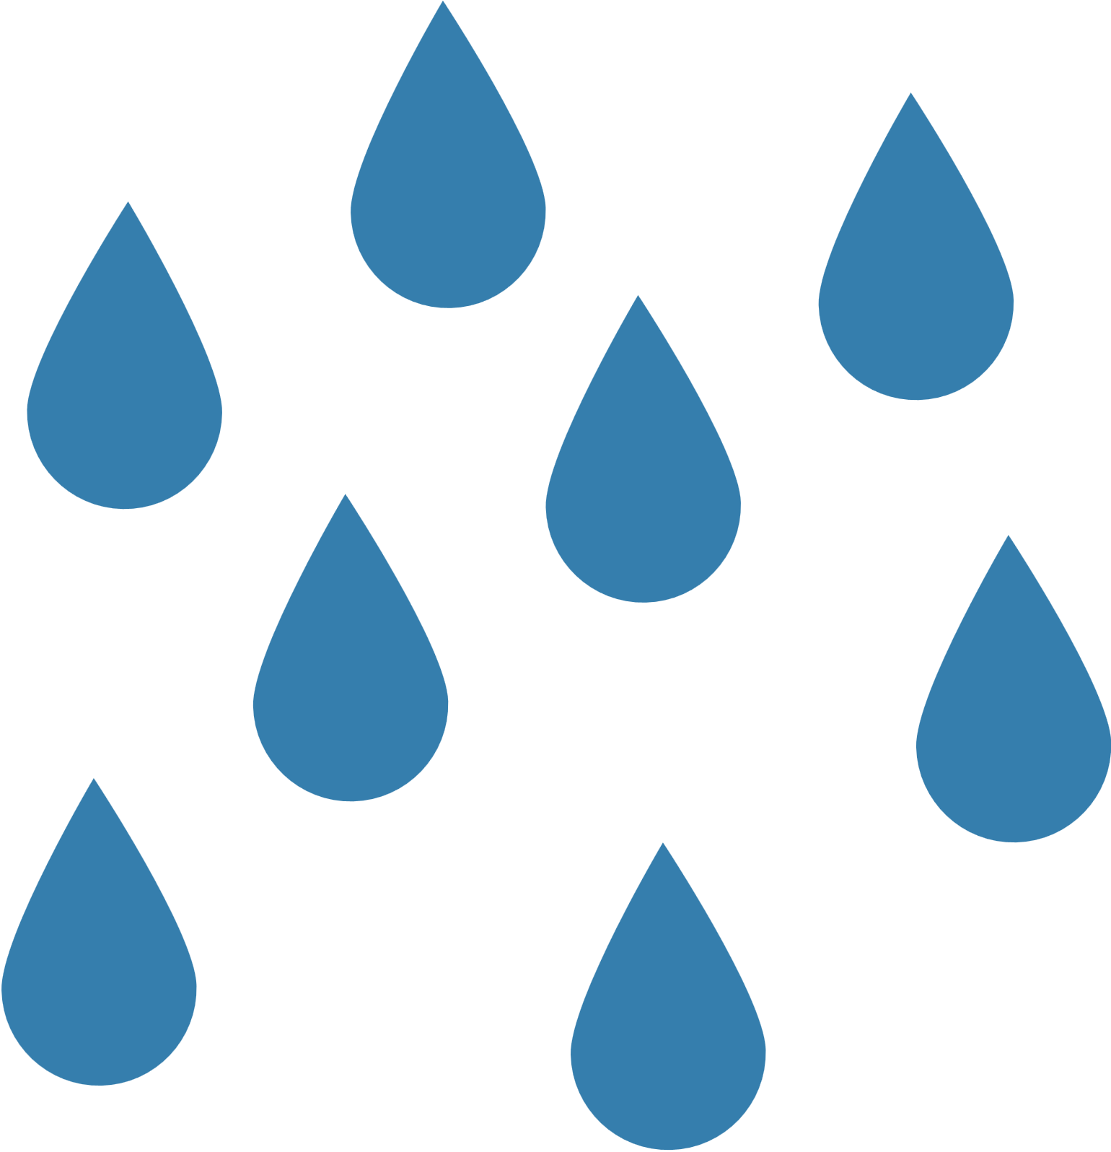


Water-Reduced Treatment
Control
Water-Addition Treatment
ElbowLakeCentre.ca © Queen’s University Biological Station (QUBS), 2023

Slide 7

Summary of the Study:
Since there are many factors that affect plant growth which are all interdependent, we will only simplify the results of the water treatments. They found that when they reduced the rain with rainout shelters, the soil water content (how much water is in the soil) decreased, and when they increased the rain with the water-addition treatment, the soil water content increased. With the water-reduction treatment. They also found that the alive, above-ground plant biomass decreased from the rainout shelters treatment, and they even saw more dead biomass as the plants were living in drought-like conditions. This may also have been the result of reduced soil moisture and reduced soil nutrients. The water-addition treatment did not change live above ground plant biomass compared to ambient (control) precipitation, but it did increase species richness.
ElbowLakeCentre.ca © Queen’s University Biological Station (QUBS), 2023

Slide 8

Results:
Water-Reduced Treatment:
Soil water content decreased, alive above-ground plant biomass decreased, and they save more dead above-ground plant biomass
Water-Addition Treatment:
Soil water content increased, no change in alive above-ground plant biomass compared to control (normal precipitation) treatment
Above-ground Plant Biomass
ElbowLakeCentre.ca © Queen’s University Biological Station (QUBS), 2023

Slide 9
Reflection Question
Therefore, as there is an expected decreased rainfall in the summer months of the Great Lakes region, what does this mean for some plants?
ElbowLakeCentre.ca © Queen’s University Biological Station (QUBS), 2023

Slide 10

Next Task
Now, we will try our own experiment to test the impact of rainfall on bean plants.
ElbowLakeCentre.ca © Queen’s University Biological Station (QUBS), 2023

