Slide 1
The Role of Water in Ceremonies
ElbowLakeCentre.ca © Queen’s University Biological Station (QUBS), 2023

Slide 2
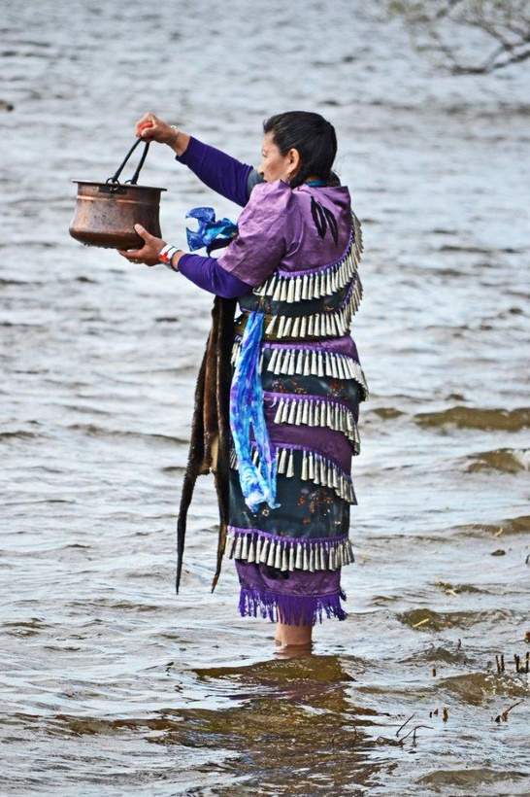
Water Walks
Water Walking is an important ceremony that raises awareness about the importance of taking care of water and recognizing its sacredness.
This ceremony is also a way of thanking the water for all that it gives to Creation.
In a Water Walk, women usually lead the ceremony and carry a copper pail of water.
Many Anishinaabe and Haudenosaunee women take part in water walks locally.
ElbowLakeCentre.ca © Queen’s University Biological Station (QUBS), 2023
Notes:
Image: https://www.cbc.ca/news/indigenous/great-lake-water-walk-meant-to-spread-awareness-open-to-all-1.4303050
http://www.motherearthwaterwalk.com/?page_id=11

Slide 3
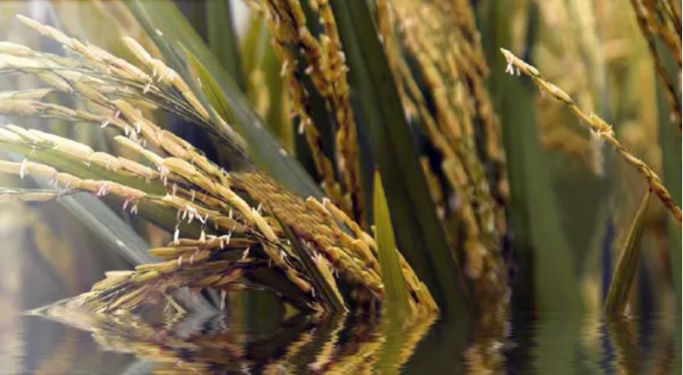
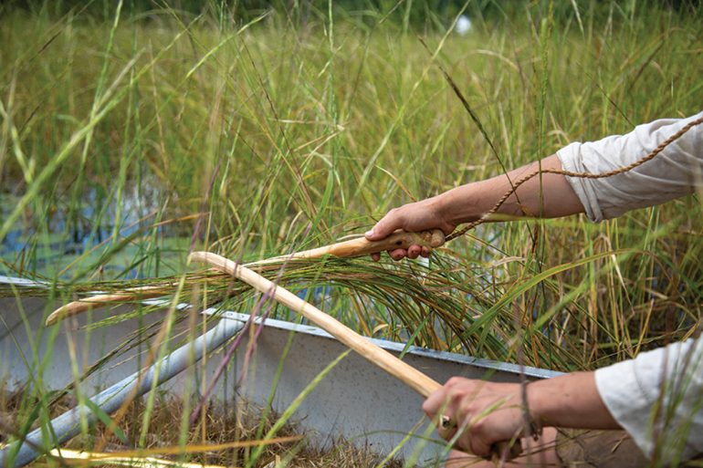
Wild Ricing
It is said that hundreds of years ago the Anishinaabe followed a vision in search for their homeland “where the food floats on the water”.
This led the Ojibwe to Lake Superior where they found wild rice (Manoomin) growing. Manoomin is sacred to the Anishinaabe.
Harvests are done with care, ensuring that many of the seeds are left in the water.
These seeds will grow the Manoomin for the next year.
ElbowLakeCentre.ca © Queen’s University Biological Station (QUBS), 2023
Notes:
Image: https://downeast.com/food-drink/wild-ride/
https://www.indigenousexperienceontario.ca/listing/anishinaabe-wild-rice/

Slide 4
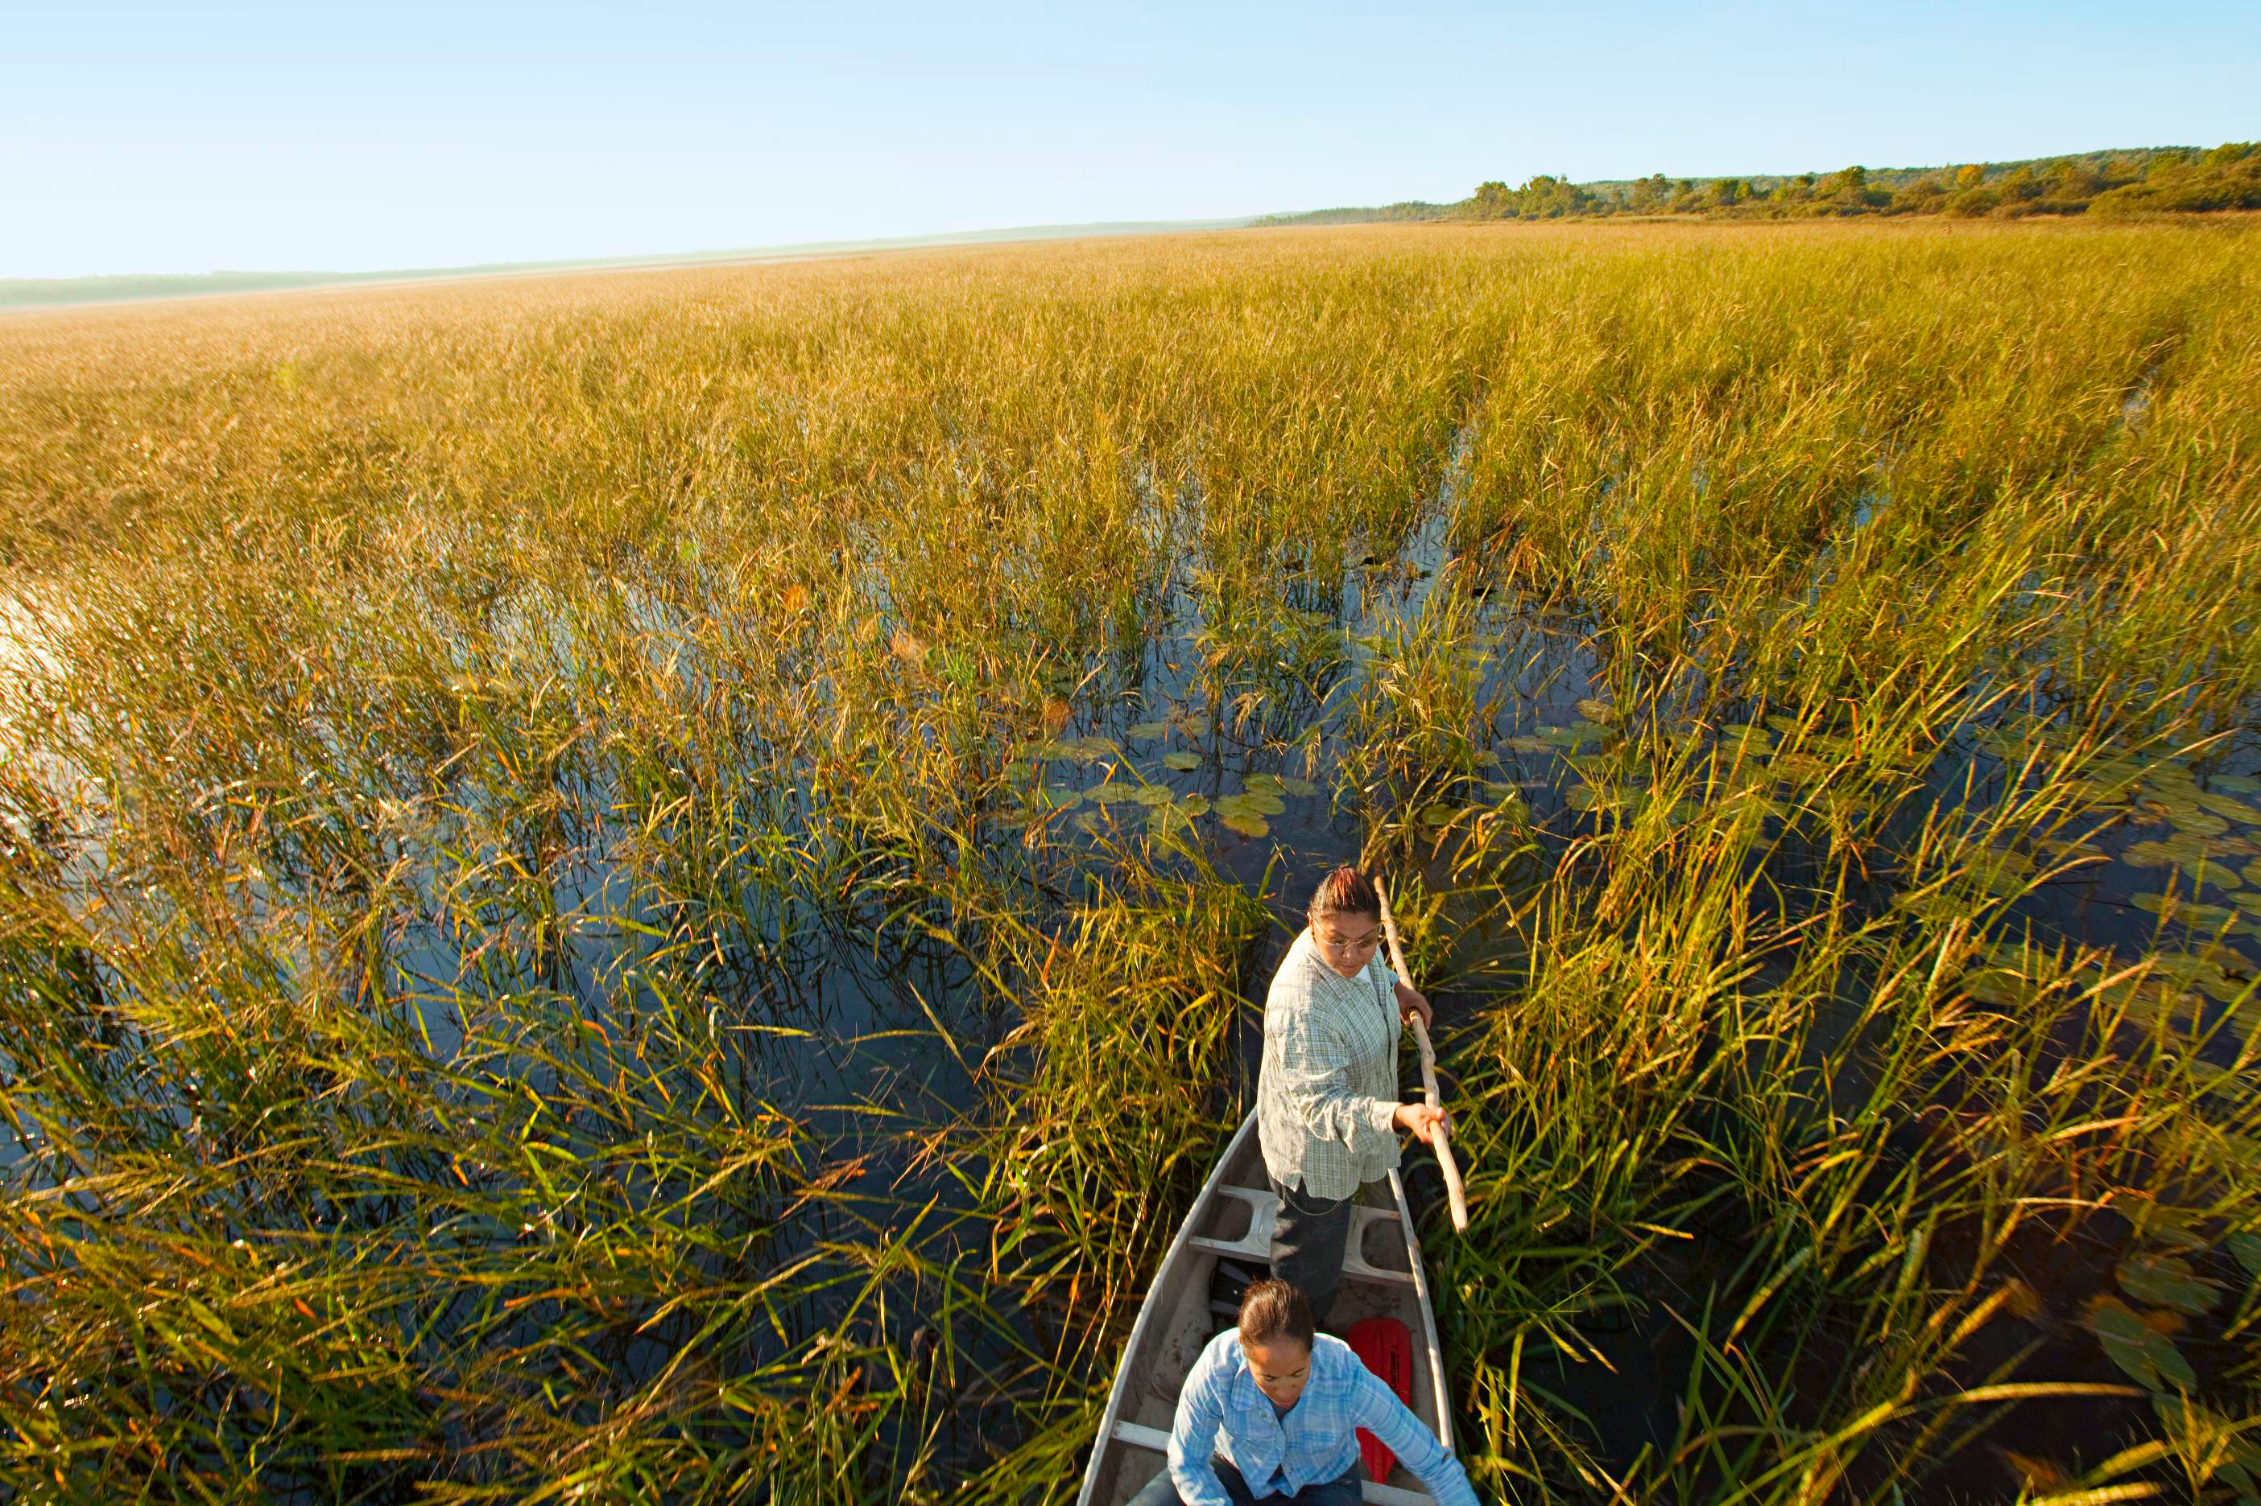
Wild Ricing
Manoomin grows in shallow, still lakes across Eastern North America.
Manoomin requires very specific environmental conditions, including clear water, water with low salt content, water that has no pollutants, and water that has a neutral pH.
The state of the water plays a critical role in the growing process.
Harvest takes place in late summer to early fall.
ElbowLakeCentre.ca © Queen’s University Biological Station (QUBS), 2023
Notes:
Image: John Noltner
https://www.midwestliving.com/food/fruits-veggies/native-harvest-ojibwe-wild-rice-gathering-minnesota/

Slide 5
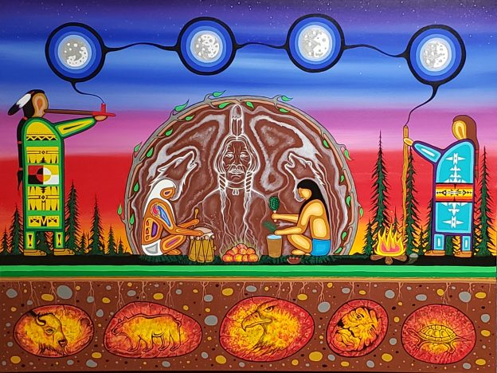
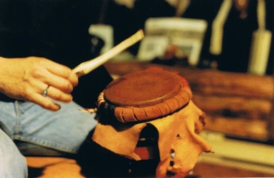
Sweat Lodge Ceremonies
Sweat lodge ceremonies are used for healing and cleansing. Traditionally they were practiced locally by the Anishinaabe. Today, many Indigenous community members including those who are Haudenosaunee partake in sweat lodge ceremonies.
Cedar water is typically poured on the rocks, which creates the steam in the lodge.
The act of pouring water over heated rocks is believed to be healing.
Artist: Red George (Ma-Mi-No-ga-boo)
ElbowLakeCentre.ca © Queen’s University Biological Station (QUBS), 2023
Notes:
Images: https://native-drums.ca/en/galleries/drum-gallery/
https://reddogartstudio.com/my-story

Slide 6
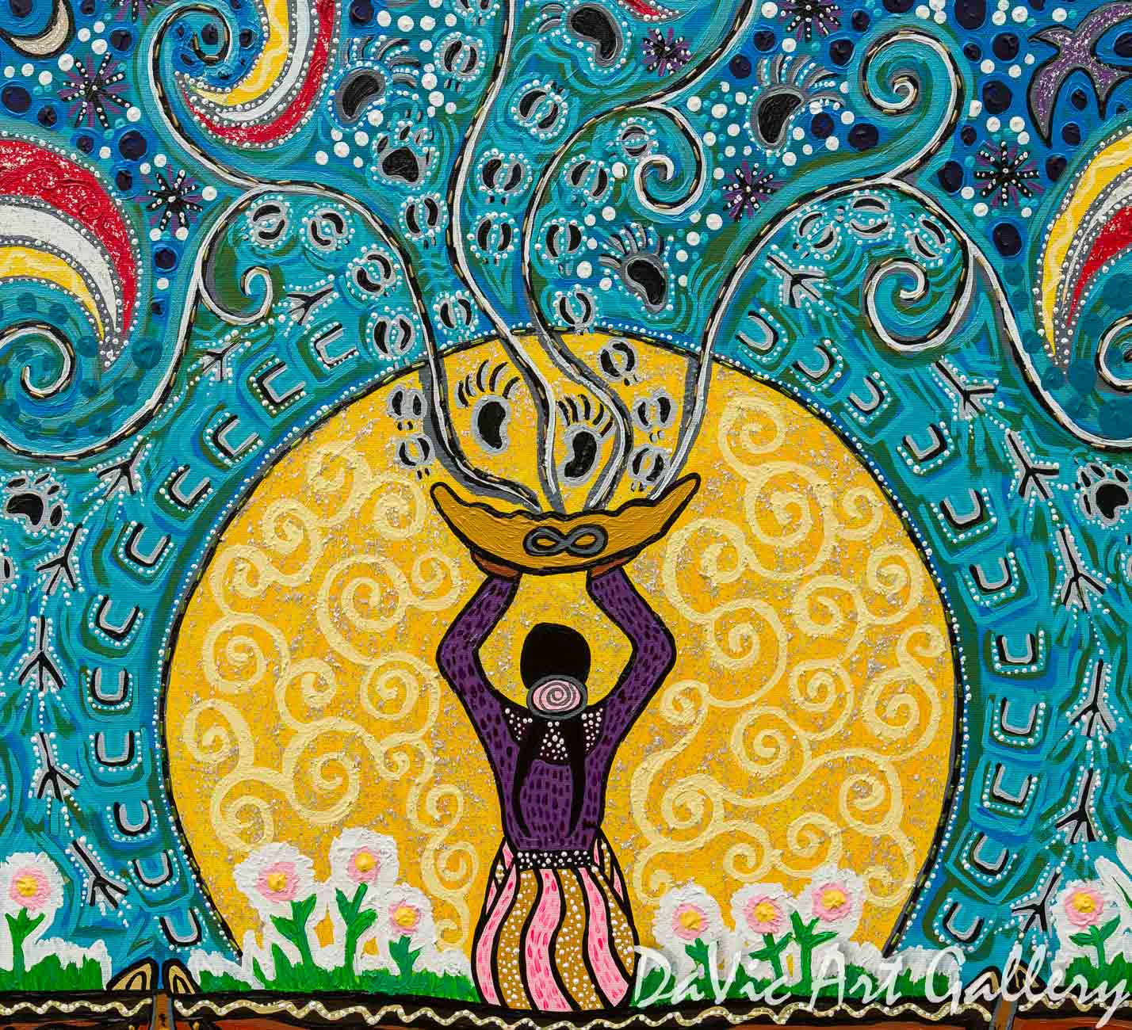
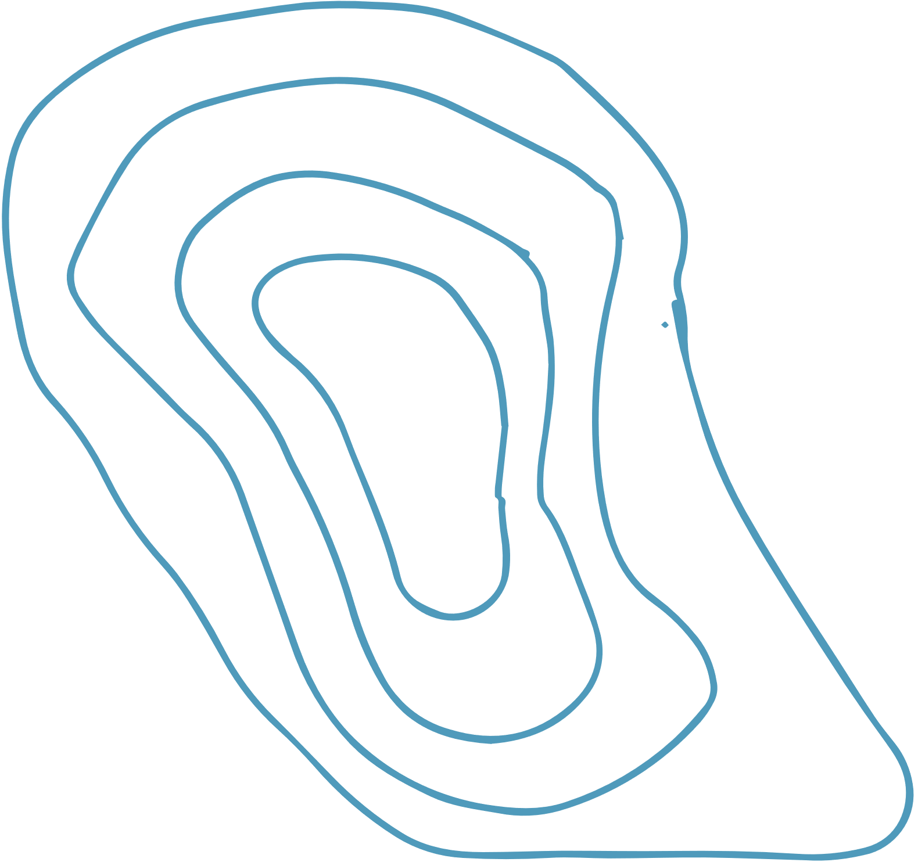
Fasting
Many Indigenous groups including the Anishinaabe and Haudenosaunee locally fast.
Fasting is the practice of abstaining from food and water to receive clarity.
To prepare for a fast, many people offer tobacco to the four elements- water, fire, wind, and earth
To end a fast, many people drink spring water or cedar water.
“Vision Quest”
Artist: Leah Marie Dorion
ElbowLakeCentre.ca © Queen’s University Biological Station (QUBS), 2023
Notes:
Images: https://nativecanadianarts.com/gallery/vision-quest/

Slide 7
Sources
https://aht.ca/wp-content/uploads/2017/12/Lodge.pdf
https://aht.ca/wp-content/uploads/2017/12/Fasting.pdf
https://www.mnopedia.org/thing/wild-rice-and-ojibwe
https://mushkiki.com/our-programs/sweat-lodge/
https://teaching.usask.ca/indigenoussk/import/sweat-lodge_ceremony.php
https://www.safewater.org/operation-water-spirit-1/2017/6/1/grade-eleven-thematic-unit-fasting-and-sweat-lodge-ceremony-information
ElbowLakeCentre.ca © Queen’s University Biological Station (QUBS), 2023

