Slide 1








REAL-WORLD STEM CONNECTION: RESEARCHER PROFILE
How can drones and environmental DNA help us to understand algal blooms?
Looking at the work of Yuixiang Wang and Allen Tian
ElbowLakeCentre.ca © Queen’s University Biological Station (QUBS), 2023

Slide 2
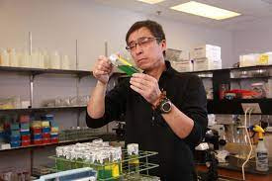

YUIXIANG WANG
ALLEN TIAN
Associate Professor
PhD Student
Queen's University Biology Department
Queen's University Biology Department
ElbowLakeCentre.ca © Queen’s University Biological Station (QUBS), 2023

Slide 3

Wang and Tian are looking at new practices to help mitigate the problem of algal blooms. Usual methods of algal bloom control often lack effectiveness, and can cause unwanted environmental changes. Therefore, they have been contributing new knowledge to the growing use and effectiveness of of UAVs and eDNA in managing algal blooms, specifically caused by cyanobacteria.
UAV stands for "unmanned aerial vehicle," which is otherwise known as a drone, and eDNA means environmental DNA, which is DNA from organisms found within the environment.
Choose a topic from the right to learn more about each factor in their research, then, explore why their research is important in ecosystem monitoring.
Cyanobacteria
Algal Blooms
eDNA
Importance of their Research
ElbowLakeCentre.ca © Queen’s University Biological Station (QUBS), 2023

Slide 4

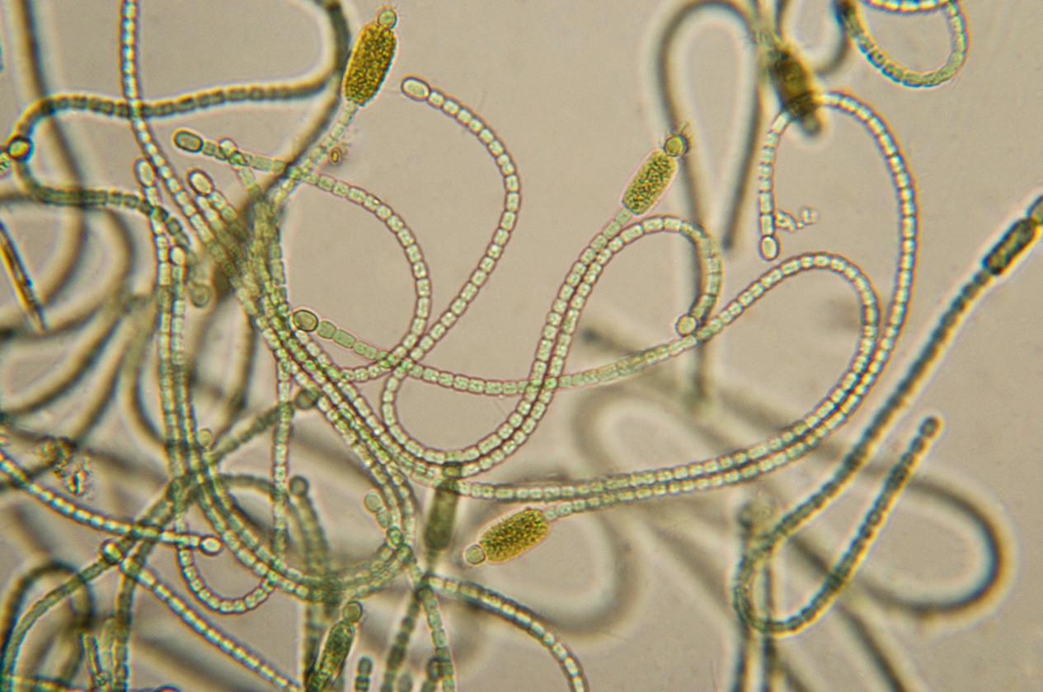
WHAT ARE CYANOBACTERIA?
Cyanobacteria:
  Are small, usually unicellular
  Are aquatic and photosynthetic
  Grow in colonies
  Found naturally in water bodies
  Often called "blue-green algae"
  Can sometimes produce cyanotoxins, and these kinds are toxic
ElbowLakeCentre.ca © Queen’s University Biological Station (QUBS), 2023

Slide 5


WHAT ARE ALGAL BLOOMS?
Algal blooms:
  Are formed from the rapid growth of algae
  Form in warm, nutrient-rich, slow-moving waters in late summer and early fall
  Can produce a foul smelling sludge or foam
  Not all blooms are toxic, but they are becoming more common
  Appear in different kinds (created from different algae), but these researchers are focusing on cyanobacteria harmful algal blooms (cHAB)
ElbowLakeCentre.ca © Queen’s University Biological Station (QUBS), 2023

Slide 6
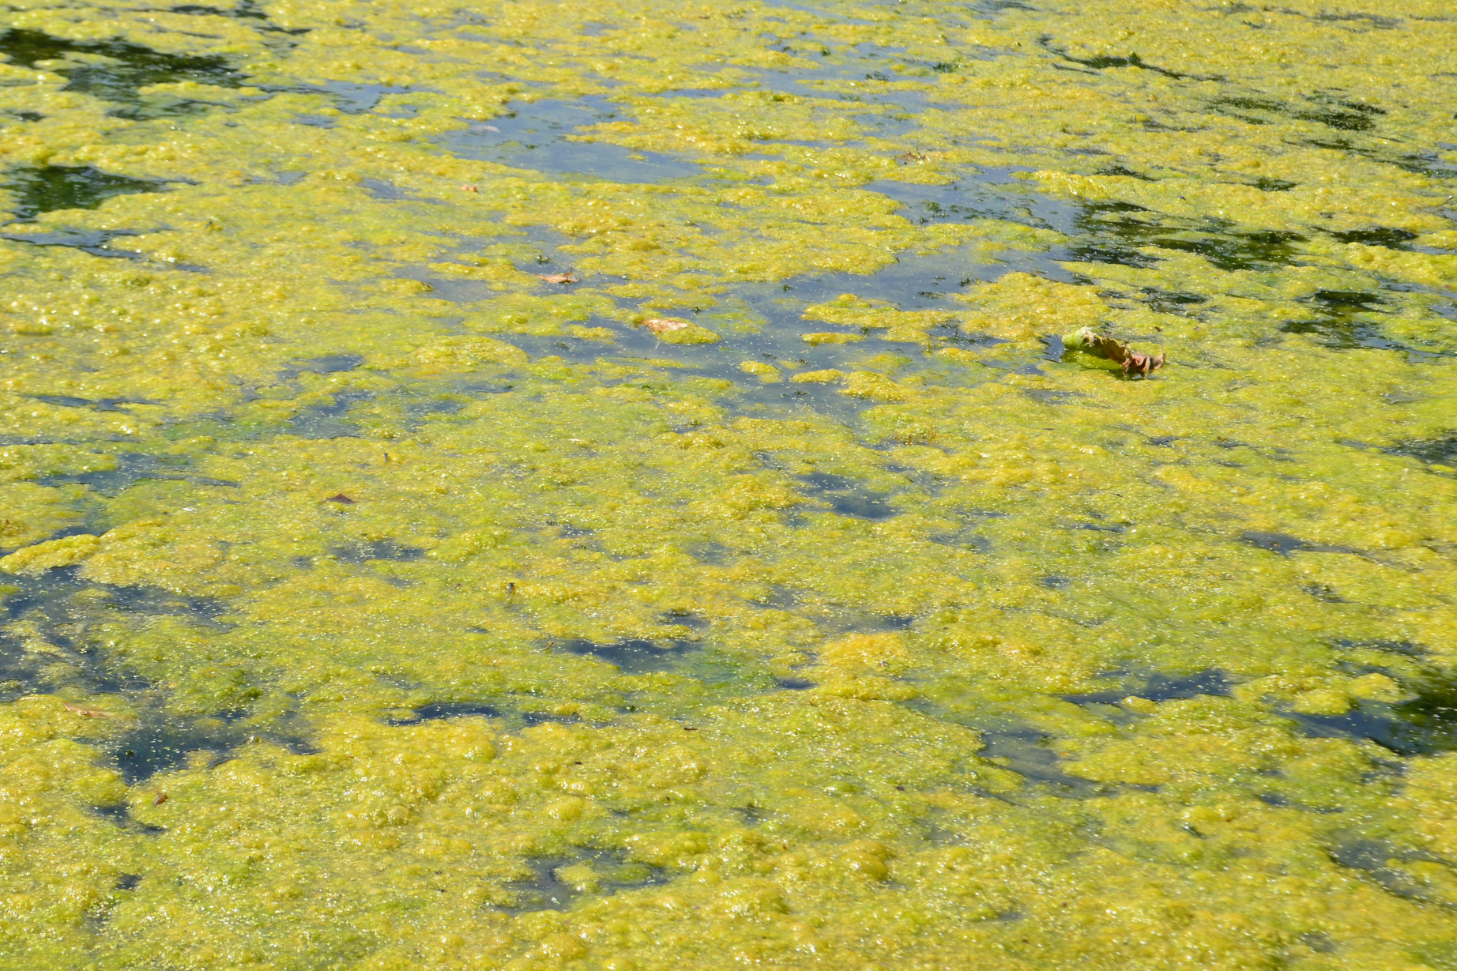
The effects on ecosystems include:
  Blocking of sunlight that is required by organisms below the bloom
  Using up oxygen and nutrients that other organisms need as well
  Releasing cyanotoxins that make people and animals sick
  Overall damage to ecosystem and affects recreational activities
Information from: National Centre for Environmental Health and National Resource Defense Council
ElbowLakeCentre.ca © Queen’s University Biological Station (QUBS), 2023

Slide 7

WHAT IS ENVIRONMENTAL DNA?
As organisms move throughout the environment, they will shed their DNA onto the environment through dead skin, mucus, feces, etc.) Scientists can take samples from the environment, extract the DNA, multiply it and detect where it comes from. For more information, check out Biomeme and watch the video below.
ElbowLakeCentre.ca © Queen’s University Biological Station (QUBS), 2023

Slide 8

WHY IS THIS IMPORTANT?
Typical practices to manage algal blooms include using clay particles to sink and bury the algae, using other species to target the algae, using chemicals to kill the algae, or manipulating the environmental conditions so that blooms do not grow. However, these can come at a cost and cause unwanted environmental changes. For more information, visit the U.S. National Office for Harmful Algal Blooms.
Furthermore, algal blooms are even worsening with climate change, through warmer temperatures, changes in salinity, and many other mechanisms listed in this EPA website.
ElbowLakeCentre.ca © Queen’s University Biological Station (QUBS), 2023

Slide 9


WHY IS THIS IMPORTANT?
Using drone technology to take pictures of the algal blooms and water samples from areas helps us to understand the whole picture of blooms and their impact. This technology will then provide more avenues for cost- effective management practices that do not pose additional threats to ecosystems.
Tian (2019) explains that drone technology
makes detecting, tracking, and quantifying
smaller, earlier detections of cHABS in smaller
waterbodies a much greater possibility, and
"similarly, UAV water sampling requires much
lighter equipment and less training than
using a boat, causes less water disturbance
and mixing, and can be faster."
ElbowLakeCentre.ca © Queen’s University Biological Station (QUBS), 2023

Slide 10



WHY IS THIS IMPORTANT?
Therefore, drone technology is used to gather water samples, which are then tested for eDNA to detect the presence of a certain cyanobacteria. If it is present, this will help the researchers determine if an algal bloom will occur, and this will also inform them on how to control it. Drone technology also helps them to understand the water conditions that correspond to the early stages of cHAB development, and their main focus is determining this potential development in small freshwater lakes in south-eastern Ontario (Tien, 2019).
Reference: Tien, A. (2019, April 24-26). 3rd Interdisciplinary freshwater harmful algal bloom workshop. IFHAB Workshop. https://www.ifhabworkshop.com/uploads/1/1/7/3/117362397/book_of_abstracts_2019-2.pdf
ElbowLakeCentre.ca © Queen’s University Biological Station (QUBS), 2023

