Slide 1
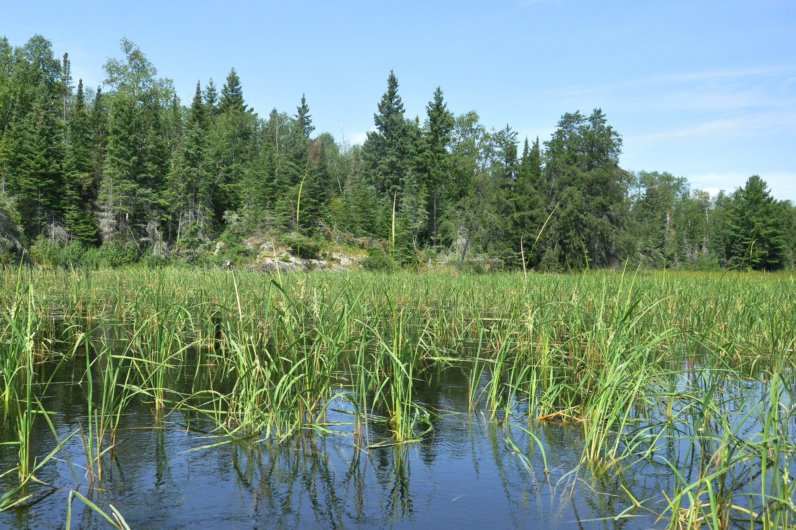

The Relationship Between Local Anishinaabe Communities and Manoomin
ElbowLakeCentre.ca © Queen’s University Biological Station (QUBS), 2023

Slide 2


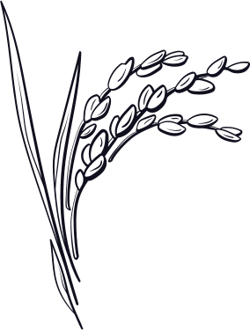

What does the name "Manoomin" tell us?
In Anishinabeebemowin, which is the Ojibway language, manoomin means the good seed", or "the sacred seed".
In Latin, which tells us the scientific name, manoomin is called Zizania aquatica, which means aquatic weeds.
In English, which tells us the common name, manoomin is called wild rice.
ElbowLakeCentre.ca © Queen’s University Biological Station (QUBS), 2023

Slide 3

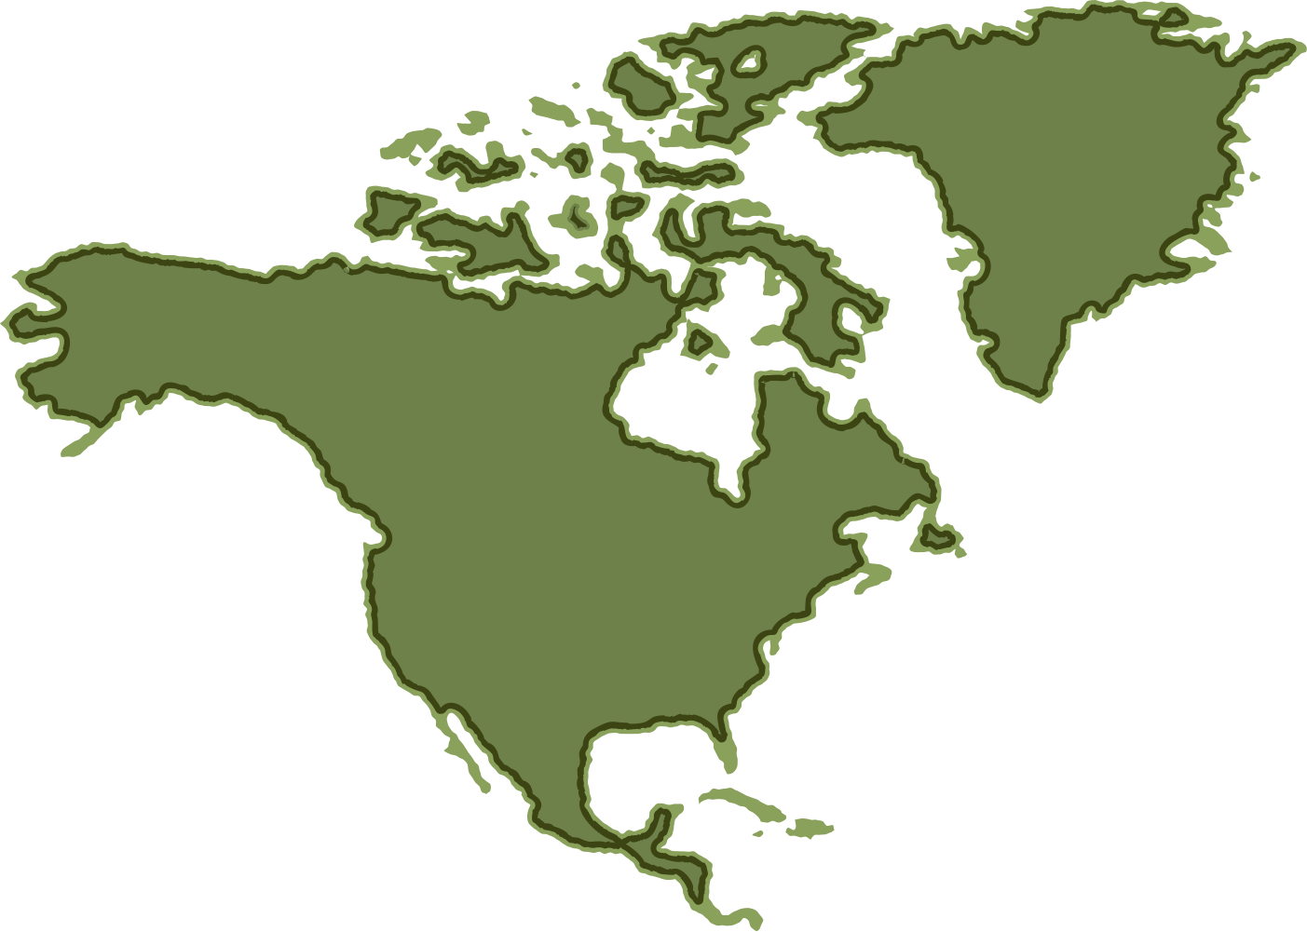

Where is Manoomin found?
Manoomin is native to North America, from the northern end of Lake Winnipeg, southward to the Gulf of Mexico, and eastward to the Atlantic Coast. It is generally found in Minnesota, USA, and in Southern Manitoba and Ontario, Canada.
ElbowLakeCentre.ca © Queen’s University Biological Station (QUBS), 2023

Slide 4

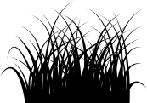

Anishinaabe and Manoomin: The Relationship of Responsibility and Reciprocity
The Anishinaabeg have maintained a reciprocal relationship with manoomin for generations. They care for it, harvest it, eat it, trade it, and honour it. It is considered to be a central way of life for the Anishinaabeg, as it has defined who they are for millennia.
The songs, ceremonies, and stories shared by the Anishinaabe demonstrate their intimate and reciprocal relationship with wild rice.
James Whetung, the founder of Black Duck Wild Rice says that "manoomin itself, is culture," as the practices involved in its harvesting and preparation embody important aspects of Anishinaabe identity, culture, and community.
The relationship with manoomin represents responsibility, reciprocity, the reclamation of identity and traditional health foods, and the protection of food sovereignty.
ElbowLakeCentre.ca © Queen’s University Biological Station (QUBS), 2023

Slide 5
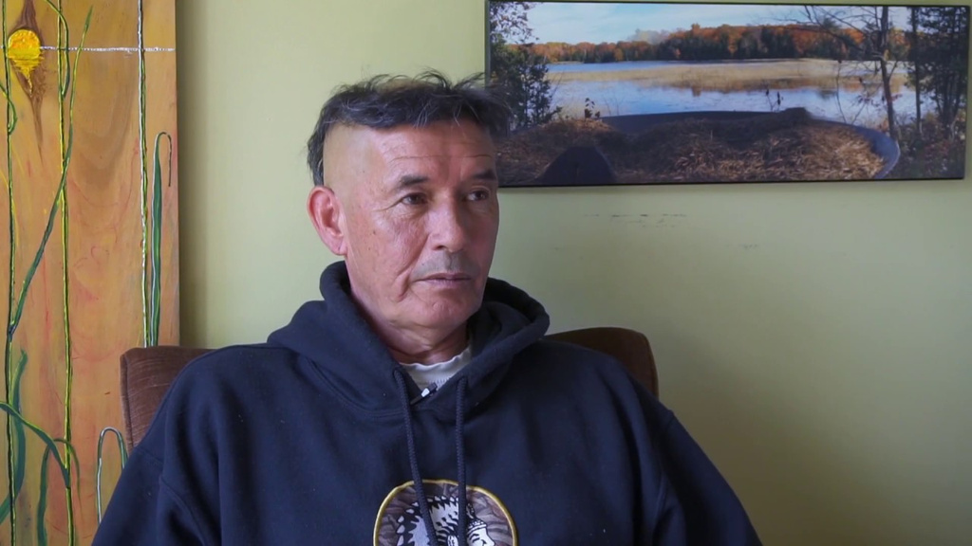
Anishinaabe and Manoomin: The Relationship of Responsibility and Reciprocity
“The wild rice speaks, it speaks softly, yet it wants to be heard. It will speak and you will become aware. The more the seeds grow together, they love community, a large community and their strength is in their voices and as they grow in numbers they are more audible to mainstream society. It has a lot to teach us about culture and about society… as it is a society and it is a diverse society. There are many strains of wild rice, there are many levels of creation living in the rice, all with different needs and wants and so to me wild rice is a reflection of us as a people. And many of the things that has happened to wild rice have happened to us, and when I say us I don’t just mean Nishnaabe. I mean all people on the land, it has happened to us all, we’ve forgotten, we have become weak and scattered in our need and want for community.”
- James Whetung in Black Duck Wild Rice: A Case Study
ElbowLakeCentre.ca © Queen’s University Biological Station (QUBS), 2023

Slide 6
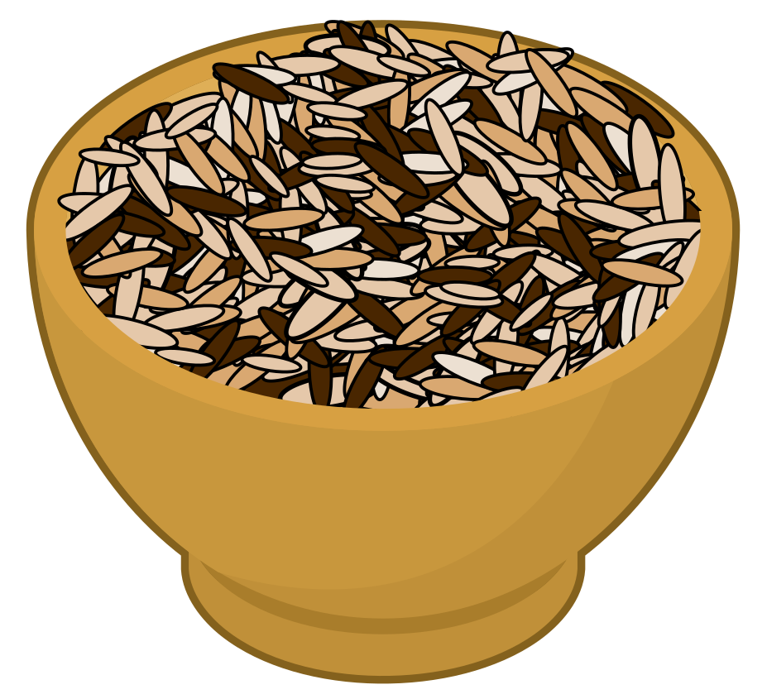
Next, we will learn how manoomin grows!
ElbowLakeCentre.ca © Queen’s University Biological Station (QUBS), 2023

