Slide 1


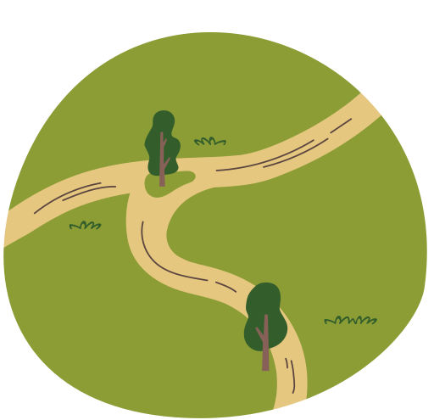
Land Changes Over the Years
Kingston, Ottawa and The Queen's University Biological Station Locations
ElbowLakeCentre.ca © Queen’s University Biological Station (QUBS), 2023

Slide 2
In the next slides, you will see images of Kingston, Amherstview, Ottawa and The Queen's University Biological Station. Using the labelled areas, examine how the land changed over the course of 20-30 years.
All of the images in the slides are from Google Earth Pro, which can be freely downloaded using this link.
ElbowLakeCentre.ca © Queen’s University Biological Station (QUBS), 2023

Slide 3
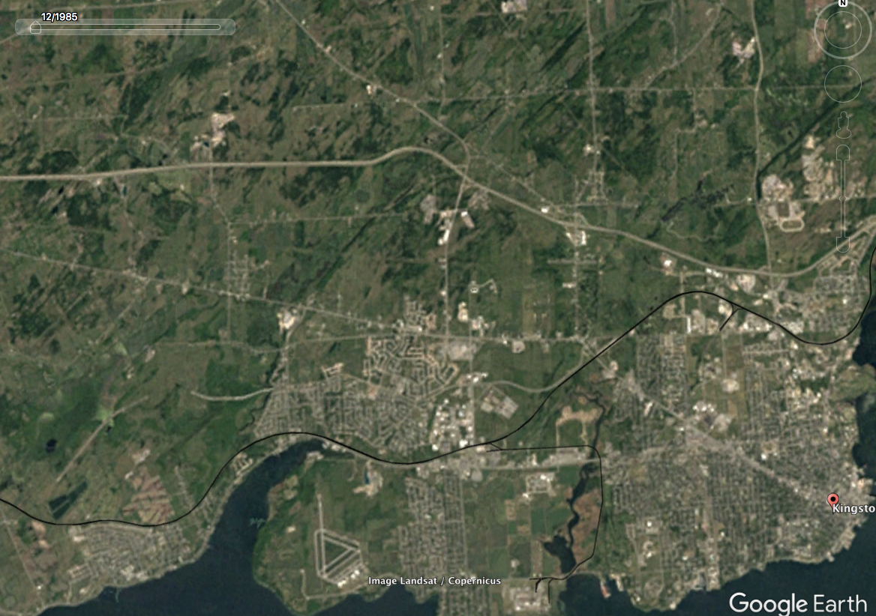
Kingston, ON (1985).
ElbowLakeCentre.ca © Queen’s University Biological Station (QUBS), 2023

Slide 4
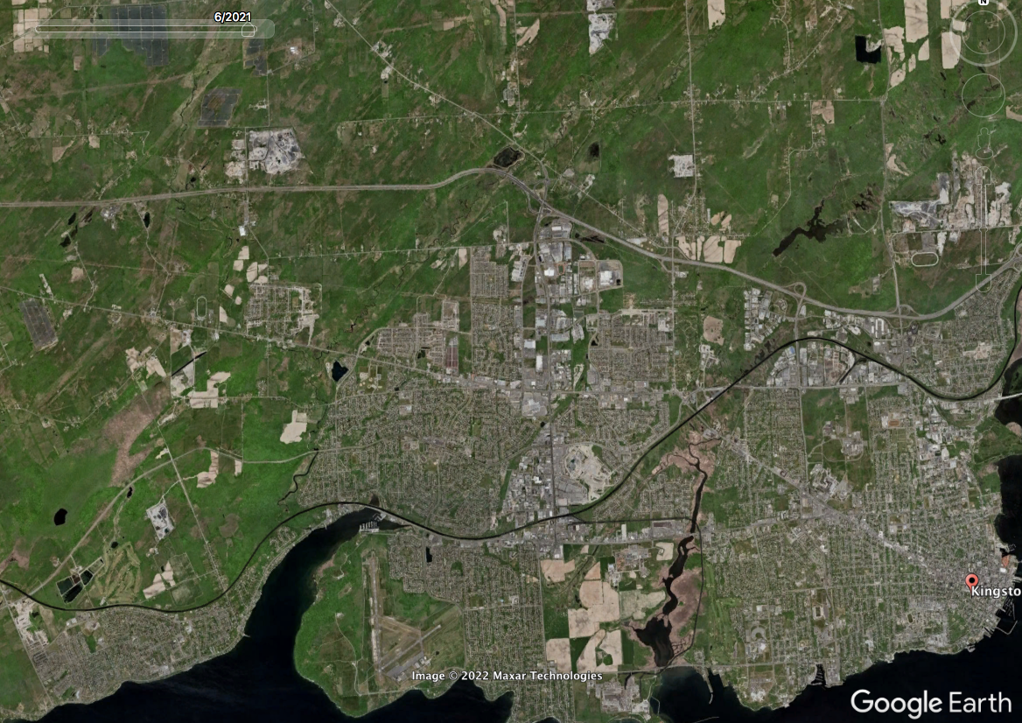
Kingston, ON (2021).
ElbowLakeCentre.ca © Queen’s University Biological Station (QUBS), 2023

Slide 5
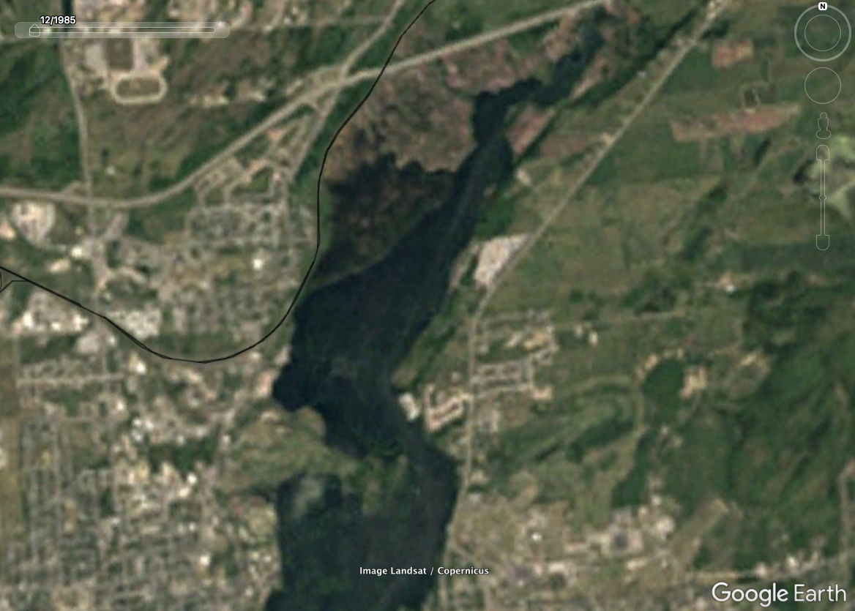
Kingston NorthEast End, ON (1985).
ElbowLakeCentre.ca © Queen’s University Biological Station (QUBS), 2023

Slide 6
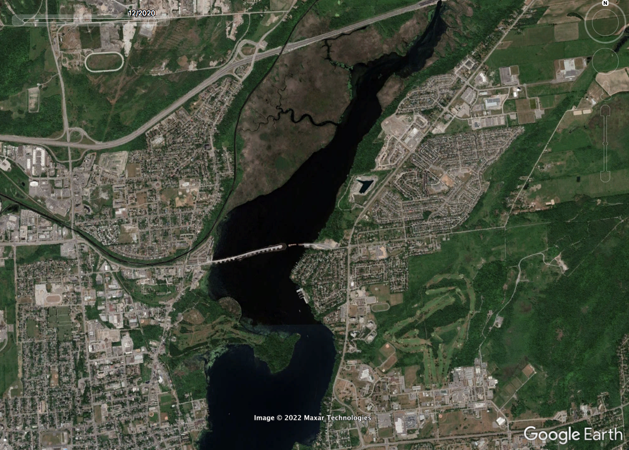
Kingston NorthEast End, ON (2020).
ElbowLakeCentre.ca © Queen’s University Biological Station (QUBS), 2023

Slide 7
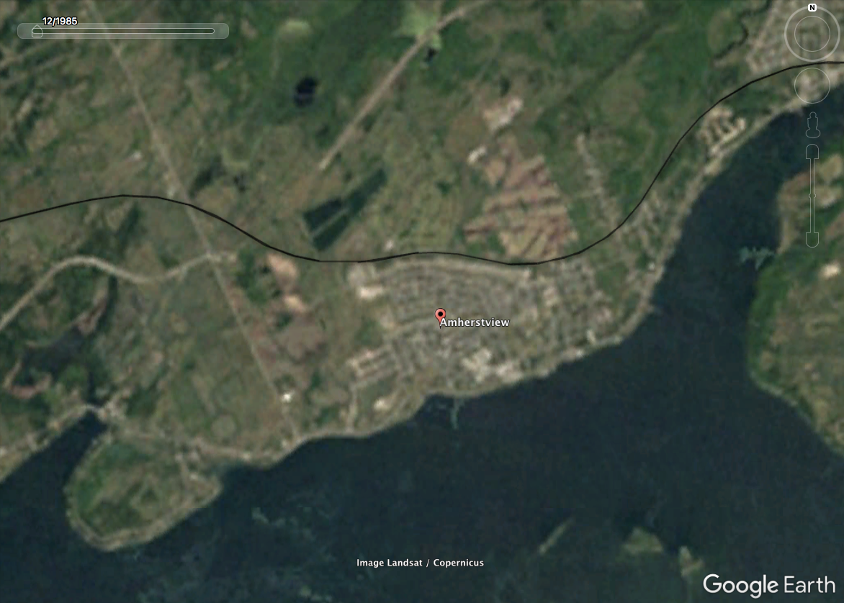
Amherstview, ON (1985).
ElbowLakeCentre.ca © Queen’s University Biological Station (QUBS), 2023

Slide 8
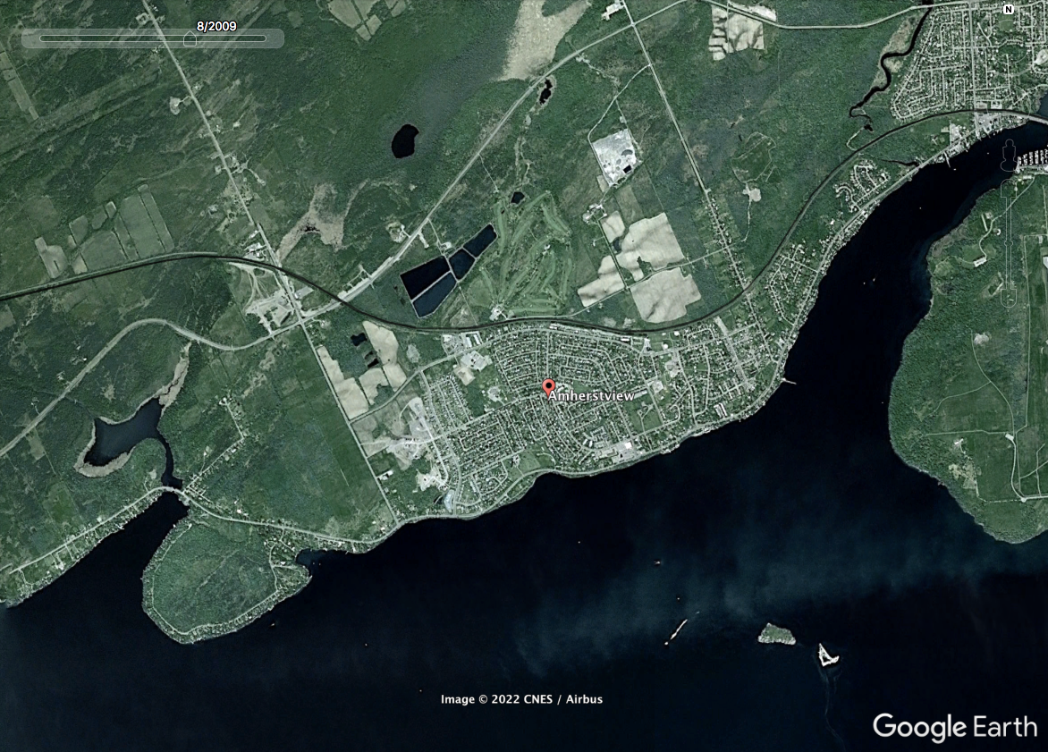
Amherstview, ON (2009).
ElbowLakeCentre.ca © Queen’s University Biological Station (QUBS), 2023

Slide 9
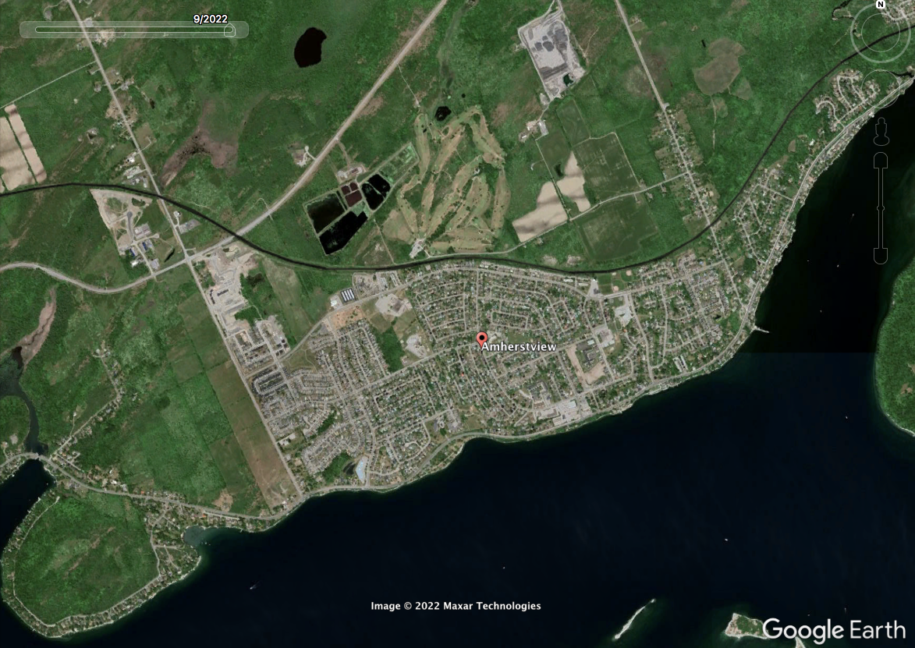
Amherstview, ON (2022).
ElbowLakeCentre.ca © Queen’s University Biological Station (QUBS), 2023

Slide 10
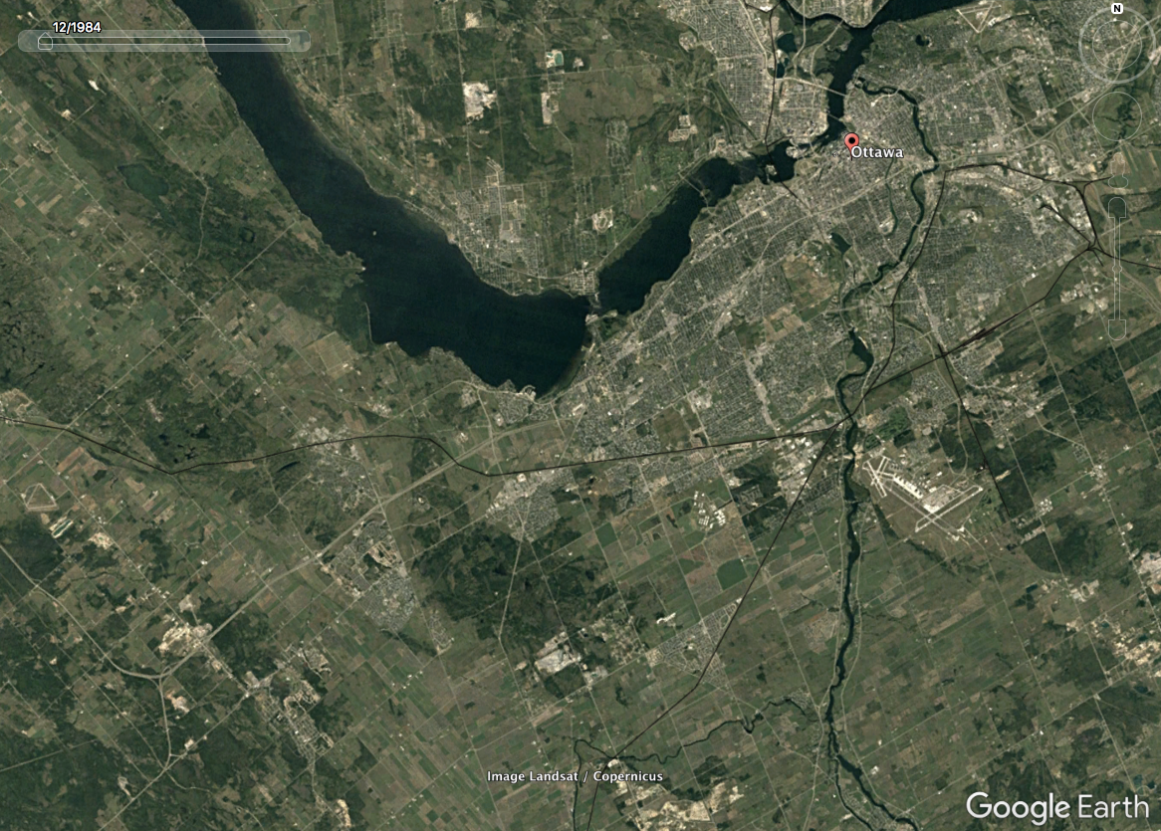
Ottawa,
ON (1984).
ElbowLakeCentre.ca © Queen’s University Biological Station (QUBS), 2023

Slide 11
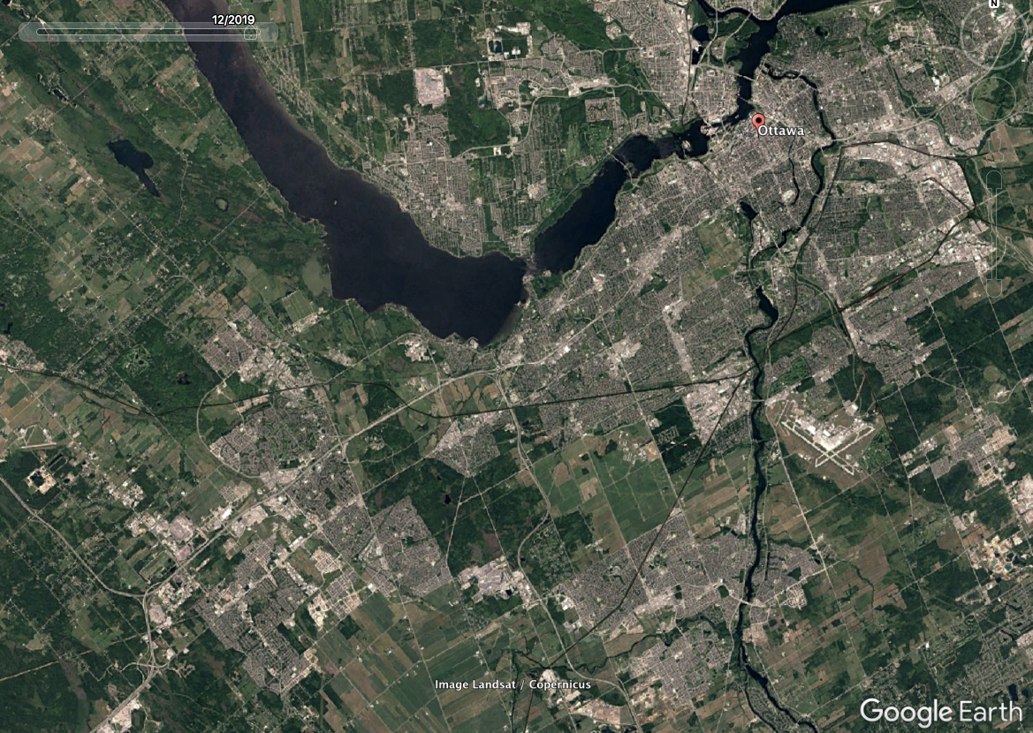
Ottawa,
ON (2019).
ElbowLakeCentre.ca © Queen’s University Biological Station (QUBS), 2023

Slide 12
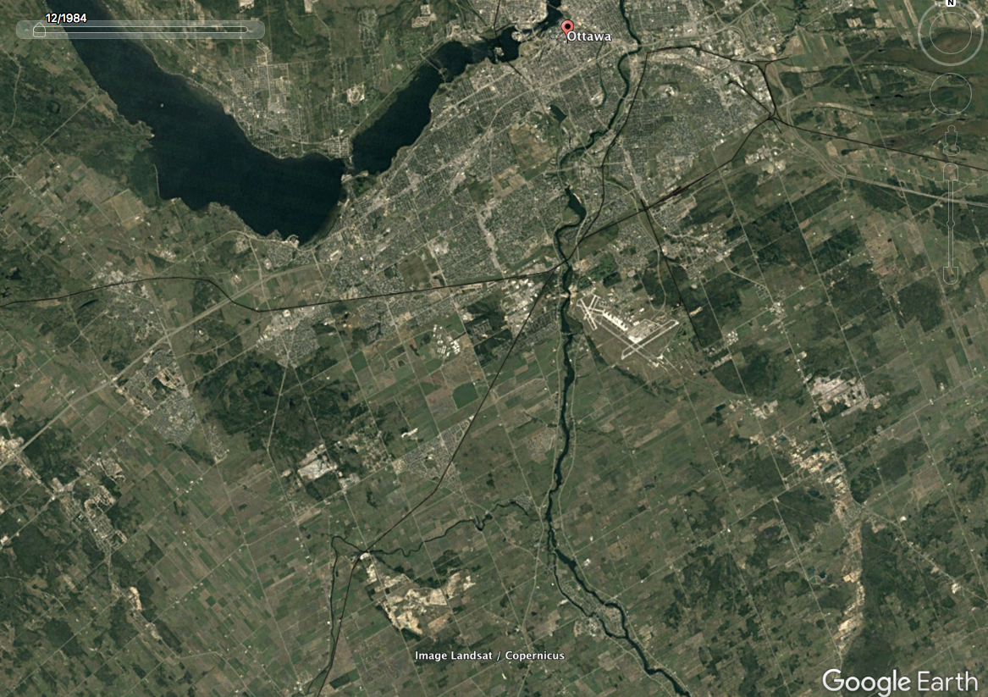
Ottawa,
ON (1984).
ElbowLakeCentre.ca © Queen’s University Biological Station (QUBS), 2023

Slide 13
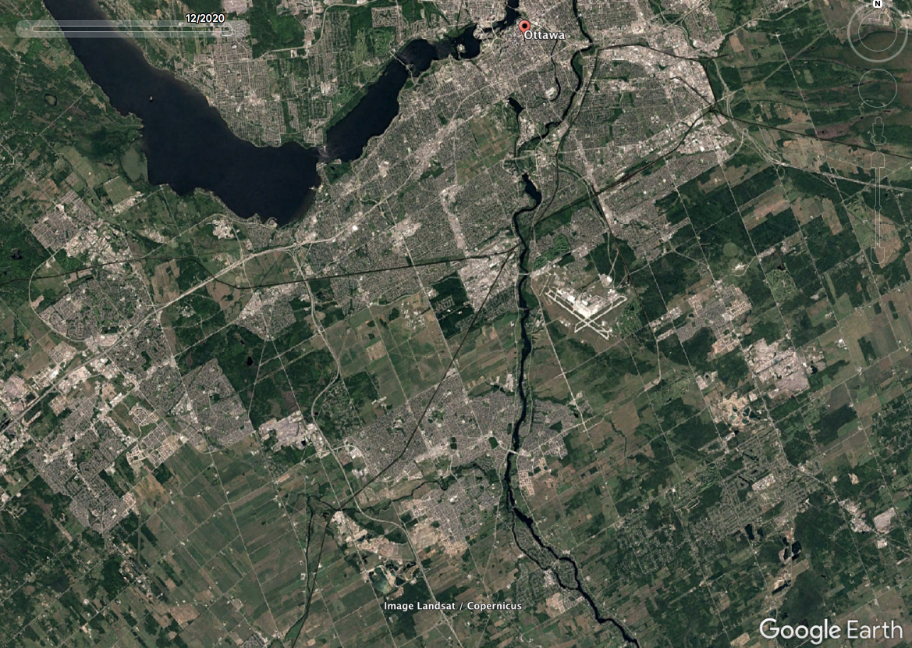
Ottawa,
ON (2020).
ElbowLakeCentre.ca © Queen’s University Biological Station (QUBS), 2023

Slide 14
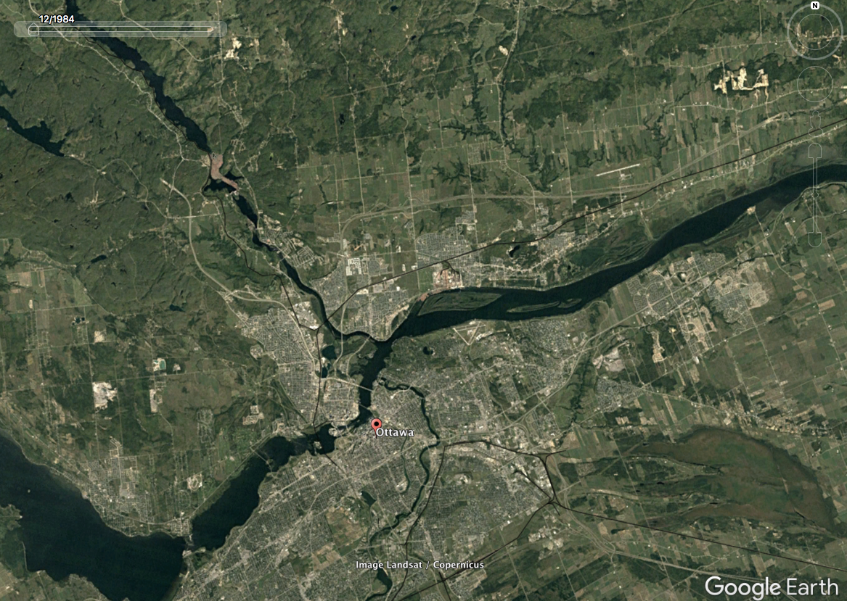
Ottawa,
ON (1984).
ElbowLakeCentre.ca © Queen’s University Biological Station (QUBS), 2023

Slide 15
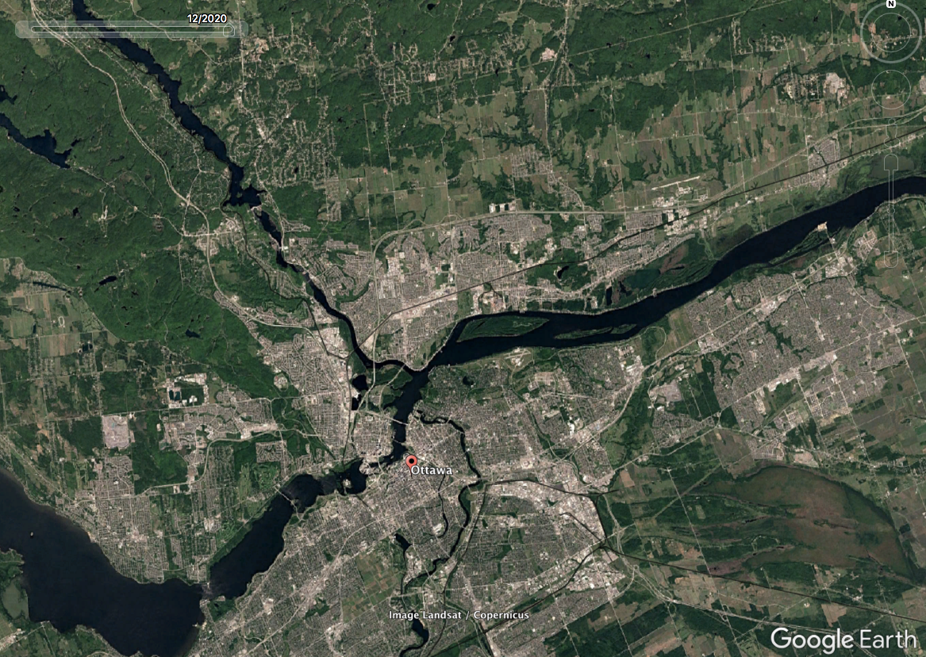
Ottawa,
ON (2020).
ElbowLakeCentre.ca © Queen’s University Biological Station (QUBS), 2023

Slide 16
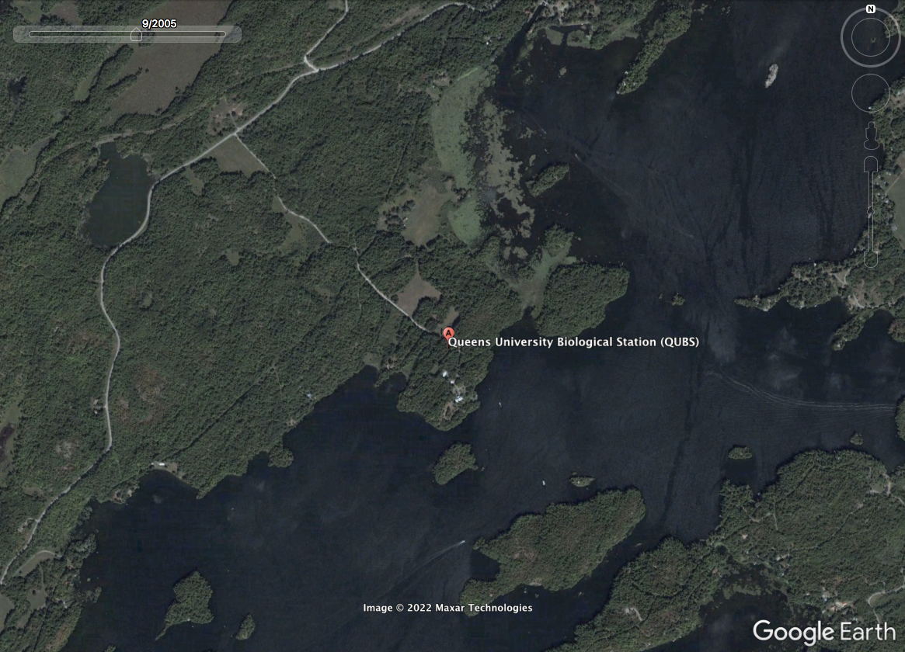
Queen's University Biological Station,
ON (2005).
ElbowLakeCentre.ca © Queen’s University Biological Station (QUBS), 2023

Slide 17
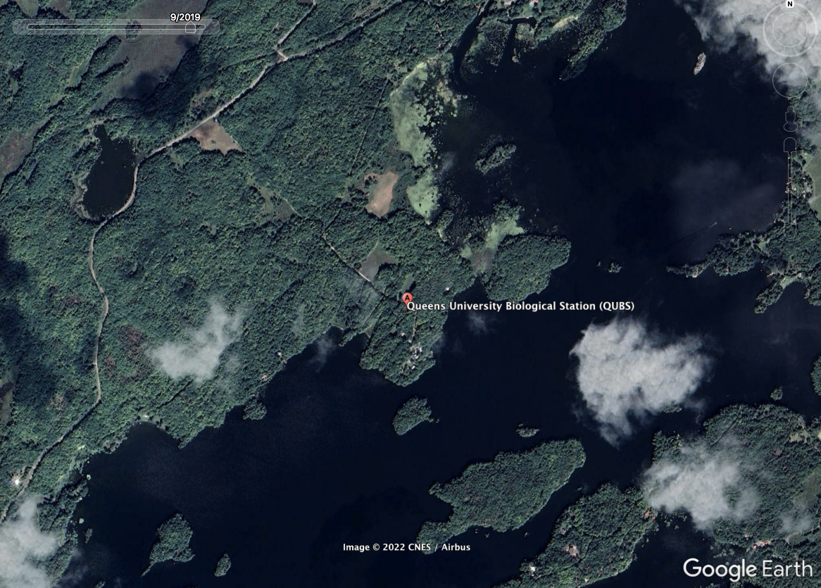
Queen's University Biological Station,
ON (2019).
ElbowLakeCentre.ca © Queen’s University Biological Station (QUBS), 2023

Slide 18

Questions to Reflect on:
  What changes did you see throughout the years?
  How might have this development affected
  natural ecosystems?
  Is there anything different you noticed about the QUBS location?
ElbowLakeCentre.ca © Queen’s University Biological Station (QUBS), 2023

