Slide 1
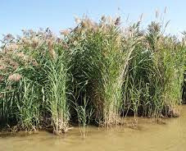
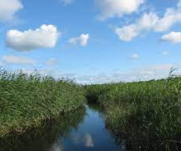
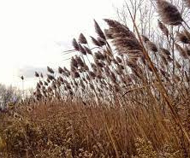
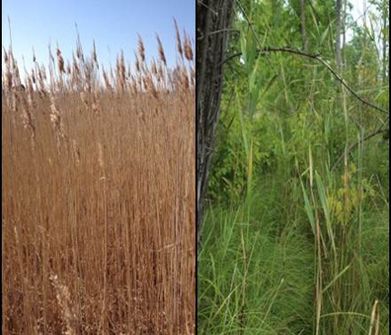
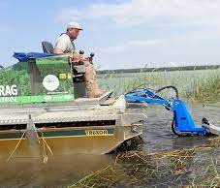
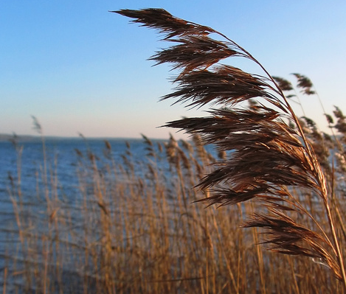
What to Know About Invasive Phragmites
Click on the images below to learn more about the invasive phragmites plant.
PHOTO CREDITS
WHAT ARE PHRAGMITES?
WHY ARE THEY INVASIVE?
WHAT IS THEIR IMPACT?
HOW TO IDENTIFY
HOW TO MANAGE
RESOURCES
ElbowLakeCentre.ca © Queen’s University Biological Station (QUBS), 2023

Slide 2
What are Phragmites?
Phragmites is a species of plant. However, there is an invasive kind that is causing great damage to wetlands, beaches, and biodiversity in Ontario and other places.
It is a perennial grass that is originally from Europe and Asia, although it is unclear how it arrived here.
ElbowLakeCentre.ca © Queen’s University Biological Station (QUBS), 2023

Slide 3
Why are they invasive?
There are native phragmites, which are called Common Reed, and then there are invasive phragmites called European Common Reed. The invasive species has certain characteristics that classify it as invasive, which include:
The ability to spread quickly
The ability to out-compete neighbouring native species for water and nutrients
The ability to release toxins from the roots in to the soil which hinders the growth of neighbouring native species
The ability to grow extremely long roots which allows it to survive in drier areas (can search farther for water)
ElbowLakeCentre.ca © Queen’s University Biological Station (QUBS), 2023

Slide 4
What is their impact?
Invasive phragmites pose a dangerous threat to the balance of ecosystems, as their impacts have been seen in many different areas. The impacts include:
Crowding out native species in an area (taking up too much space), which decreases plant diversity
Providing inadequate habitat and food sources for surrounding plants and animals
Depleting overall water levels because it grows quickly and requires a lot of water
Increasing fire hazards because of a high percentage of dead biomass
Affecting agriculture, road safety and recreational activities such as boating, swimming and angling
ElbowLakeCentre.ca © Queen’s University Biological Station (QUBS), 2023

Slide 5
How are they Identified?
Invasive Characteristics | Native Characteristics
Grow in very dense patches | Less dense
Can grow to 6 m or higher | Can grow to 2 m
Stems are tan or beige, with blue-green leaves | Stems are reddish brown with yellow-green leaves
Compact and longer seed heads | Open and smaller seed heads
Image
Image
Image
ElbowLakeCentre.ca © Queen’s University Biological Station (QUBS), 2023

Slide 6
TALLER
SHORTER
ElbowLakeCentre.ca © Queen’s University Biological Station (QUBS), 2023

Slide 7
DIFFERENT STEM & LEAF COLOUR
ElbowLakeCentre.ca © Queen’s University Biological Station (QUBS), 2023

Slide 8
Native
OPEN & SMALLER SEED HEADS
COMPACT & LONGER SEED HEADS
Invasive
ElbowLakeCentre.ca © Queen’s University Biological Station (QUBS), 2023

Slide 9
How are they Managed?
We can all contribute to the management of phragmites by:
Knowing how to properly identify them
Avoiding accidentally spreading its seeds by cleaning off shoes, clothing, pets and vehicles
Avoiding buying and/or composting them
Being knowledgeable about our local municipality's rules and protocols about invasive species
ElbowLakeCentre.ca © Queen’s University Biological Station (QUBS), 2023

Slide 10
Resources on Phragmites
The information provided in this presentation is from the first two following websites. Please check out these resource to learn more!
Invading Species Awareness Program
The Conneticiut Agricultural Experiment Station
Ontario Invasive Plant Council
ElbowLakeCentre.ca © Queen’s University Biological Station (QUBS), 2023

Slide 11
Photo Credits
Image 1. https://www.ontarioinvasiveplants.ca/invasive-plants/species/phragmites/
Image 2. https://www.greatlakesphragmites.net/blog/freshwater-wetlands-fertile-grounds-for-the-invasive-phragmites-australis-in-a-climate-change-context/
Image 3. https://www.torontogardens.com/2014/11/stop-spread-of-invasive-phragmites.html/
Image 4: https://www.greatlakesphragmites.net/blog/native-vs-invasive-phragmites/
Image 5: https://www.greatlakesphragmites.net/management/techniques/
Image 6: https://www.invasivespeciescentre.ca/invasive-species/meet-the-species/invasive-aquatic-plants/phragmites/
Image 7: https://nas.er.usgs.gov/queries/greatlakes/FactSheet.aspx?Species_ID=2937
Image 8: https://www.natureconservancy.ca/en/where-we-work/ontario/our-work/stewardship/fighting-phragmites.html
Image 9: http://www.lakeclear.org/terrestrial-invasive-plants.html
Image 10: https://www.greatlakesphragmites.net/blog/managing-phragmites-australis-on-corps-of-engineers-ecosystem-restoration-projects/
ElbowLakeCentre.ca © Queen’s University Biological Station (QUBS), 2023

