Slide 1
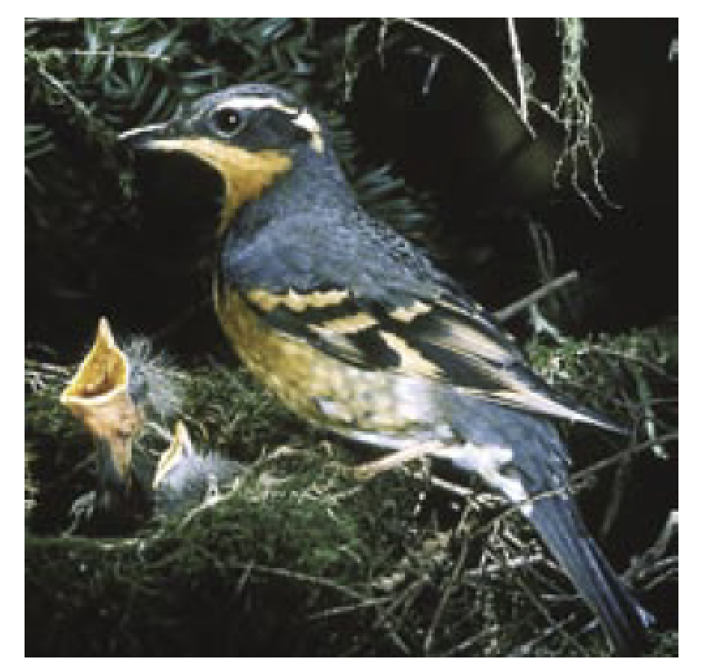
Impact of Forest Fragmentation on Thrush Species
Information taken from : Rosenberg, K.V., R.S. Hames, R.W. Rohrbaugh, Jr., S. Barker Swarthout, J.D. Lowe, and A.A. Dhondt. 2003. A land manager’s guide to improving habitat for forest thrushes. The Cornell Lab of Ornithology.
ElbowLakeCentre.ca © Queen’s University Biological Station (QUBS), 2023

Slide 2
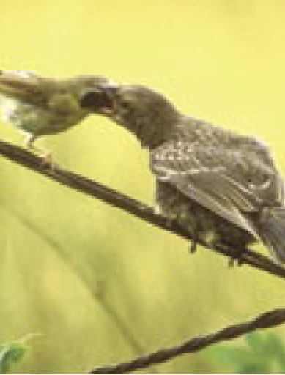
Lesson Objective
In this lesson we will examine how changes to North America forests are impacting breeding birds. Specifically, we will look at the impact of forest fragmentation on Thrush species.
ElbowLakeCentre.ca © Queen’s University Biological Station (QUBS), 2023

Slide 3
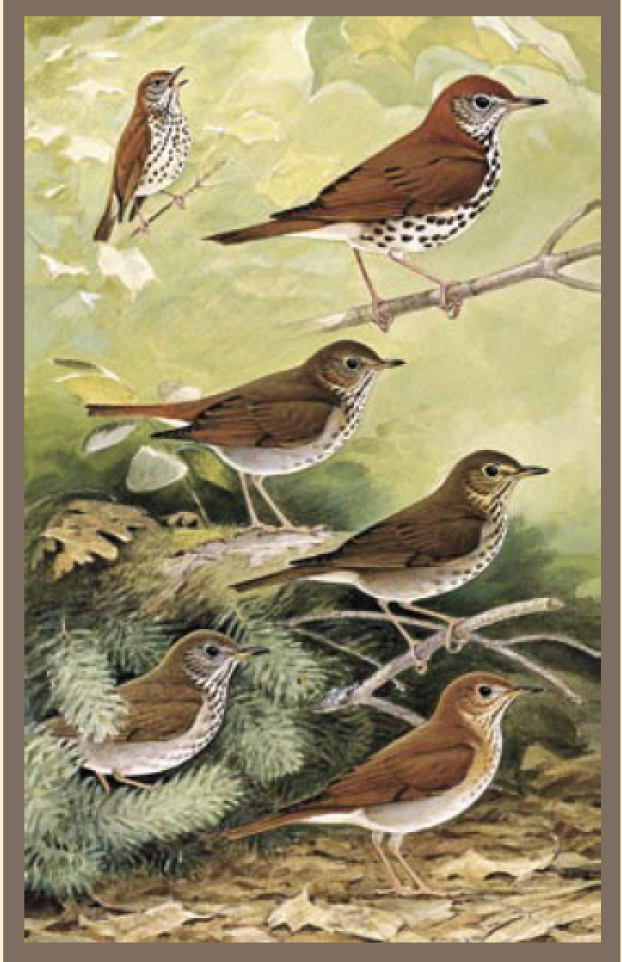
Why Thrush?
Nearly every forest in North America is inhabited by one or more thrush species.
Because of their plain coloring these songbirds often go unnoticed, however, their beautiful song can be heard throughout forested landscapes.
Thrush feed mostly on the ground and build their nests in low, dense vegetation. Each Thrush species also carefully selects its habitat based on a number of specific and important criteria.
For these reasons changes to forests have a big impact on Thrush!
ElbowLakeCentre.ca © Queen’s University Biological Station (QUBS), 2023

Slide 4
Factors Impacting Thrush Habitat Selection
ElbowLakeCentre.ca © Queen’s University Biological Station (QUBS), 2023

Slide 5
Because Thrush are sensitive to the make-up of a forest, they are good indicators of forest health:
Forests with thriving thrush populations are usually healthy.
They are also usually good ecosystems for other bird species.
Another reason we are looking at thrush species is because they are in decline.
We need to learn how to better manage our forests in order to ensure that this beautiful songbird continues to thrive in our local forests.
ElbowLakeCentre.ca © Queen’s University Biological Station (QUBS), 2023

Slide 6
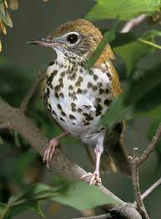
Forest Fragmentation
Can you guess what
Forest fragmentation means?
One of the biggest factors impacting Thrush and their reproductive ability is forest fragmentation.
ElbowLakeCentre.ca © Queen’s University Biological Station (QUBS), 2023

Slide 7
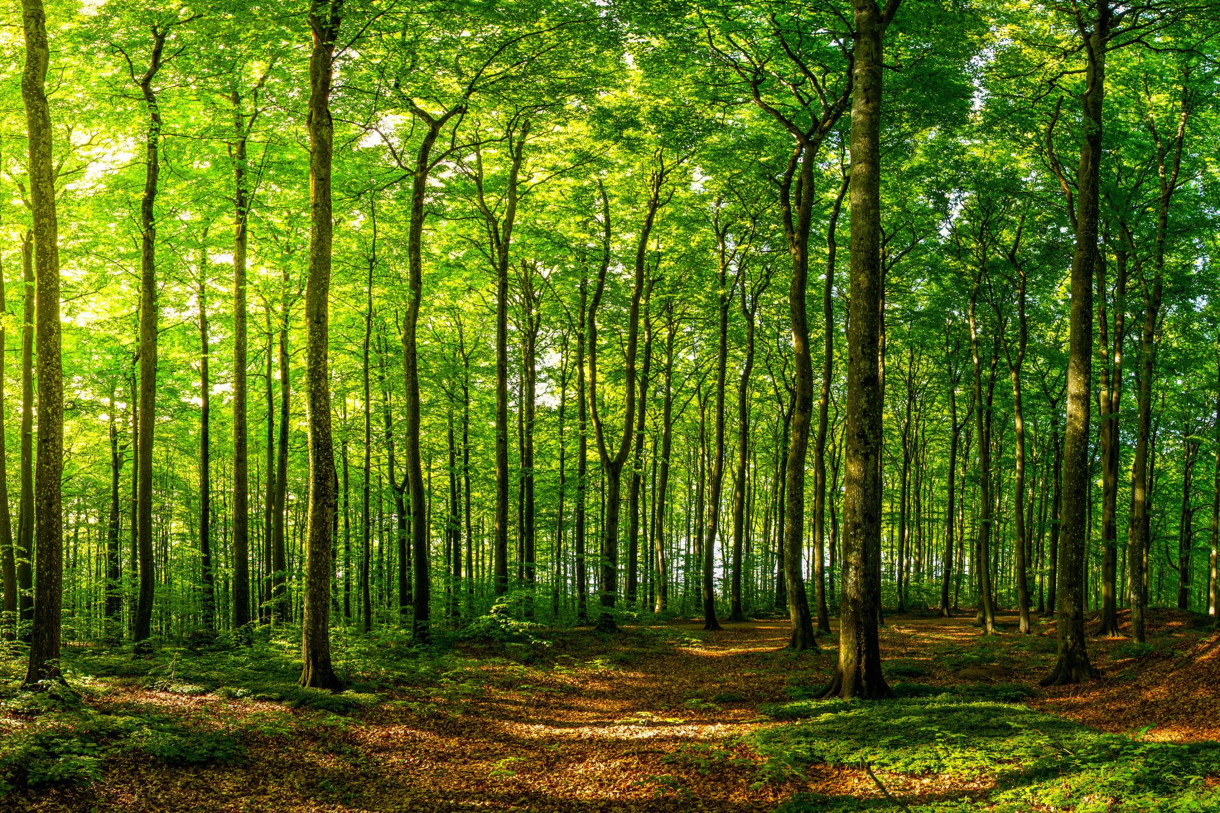
Forest Fragmentation
Forest fragmentation occurs when large forests are divided into smaller patches. Forest fragmentation is typically caused by many factors including:
Residen­tial and commercial development,
The building of roads,
Agriculture, and,
Timber harvesting.
ElbowLakeCentre.ca © Queen’s University Biological Station (QUBS), 2023

Slide 8
Forest Fragmentation in North American
In North American forests have been cut down because of their ability to provide renewable resources and sites for agriculture and development.
In the 1800s, millions of acres of forest were cleared by European settlers for agriculture and the wood products they provided.
While some of this farmland has been abandoned and replaced by forest in other areas residential and commercial development is outpacing forest regrowth.
ElbowLakeCentre.ca © Queen’s University Biological Station (QUBS), 2023

Slide 9
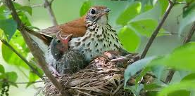
So, What's the Problem?
Forest fragmentation results in less habitat for breeding birds.
It also makes it more likely that predators will be found in the small patches of forests that do exist.
This leaves breeding birds more likely to experience brood parasitism and nest predation. This results in lower reproductive success.
Ask your teacher about brood parasitism and nest predation!!
ElbowLakeCentre.ca © Queen’s University Biological Station (QUBS), 2023

Slide 10
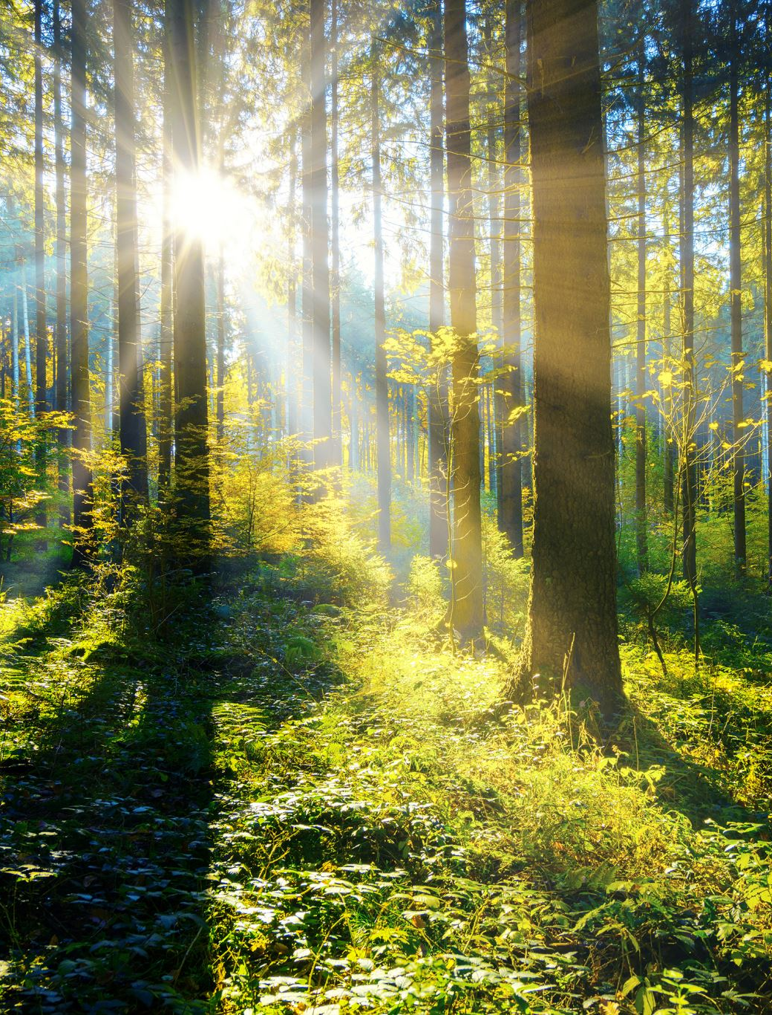
To know how to manage forests in a manner that meets the needs of bird species it is important to understand forest fragmentation in more detail.
ElbowLakeCentre.ca © Queen’s University Biological Station (QUBS), 2023

Slide 11
How Forest Fragmentation Impacts Breeding Birds
1) Size of the Patch
Forest patches that are too small do not offer enough interior habitat to sustain breeding individuals.
For this reason, many breeding birds thrive in larger forest patches.
Thrush in particular to not do well in small patches.
Bird species whose reproductive success is reduced in small habitat patches are referred to as area sensitive.
ElbowLakeCentre.ca © Queen’s University Biological Station (QUBS), 2023

Slide 12
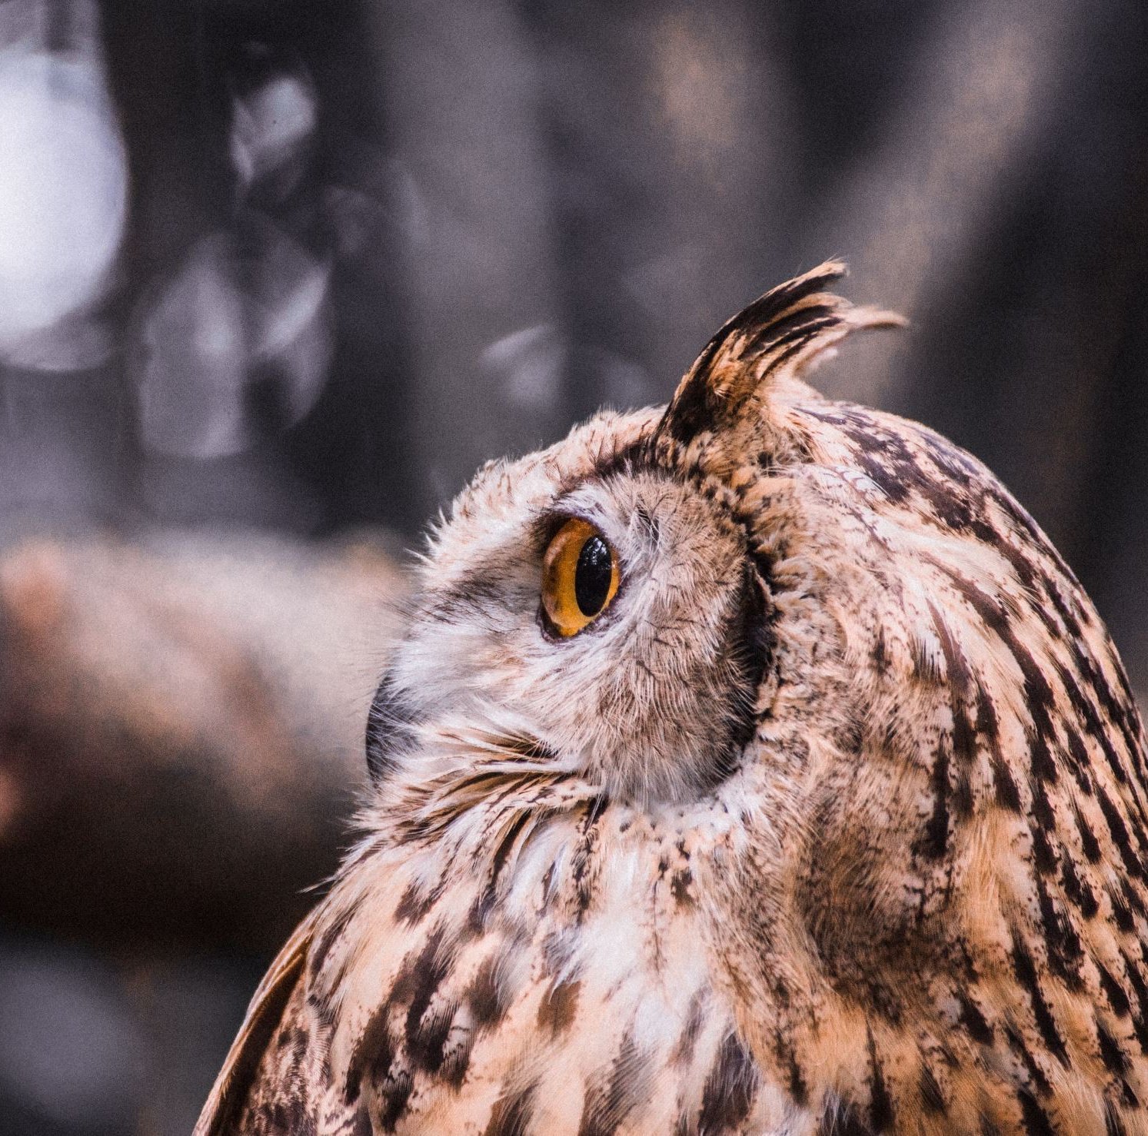
2) Shape and Distance Between Forest Patches
The degree of isolation, or the distance between a patch and the surrounding forest also impacts birds.
For nonmigratory species, such as woodpeckers and owls, the ability of young birds to disperse and establish new territory is greatly reduced when the habitat is isolated.
ElbowLakeCentre.ca © Queen’s University Biological Station (QUBS), 2023

Slide 13
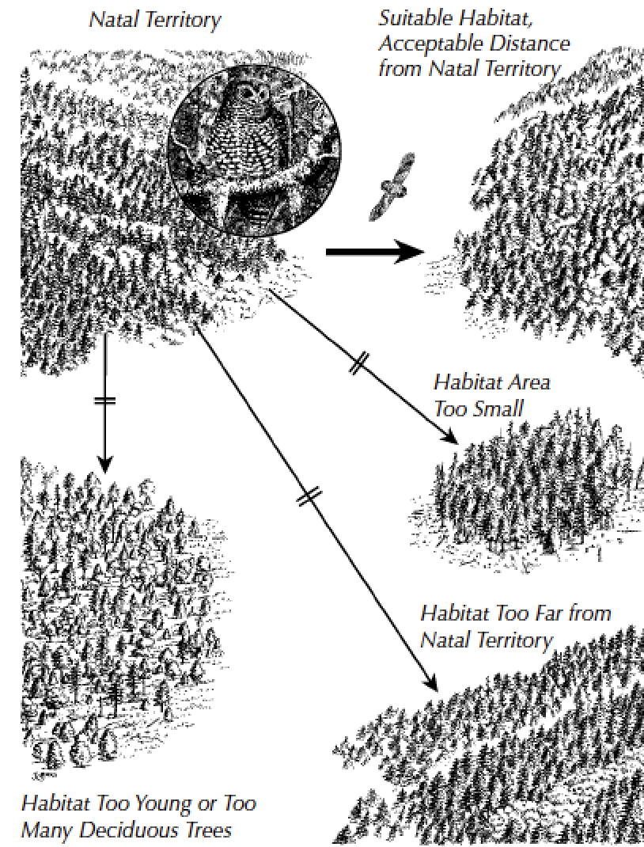
Distance between patches impacts bird's ability to establish new territory
ElbowLakeCentre.ca © Queen’s University Biological Station (QUBS), 2023

Slide 14
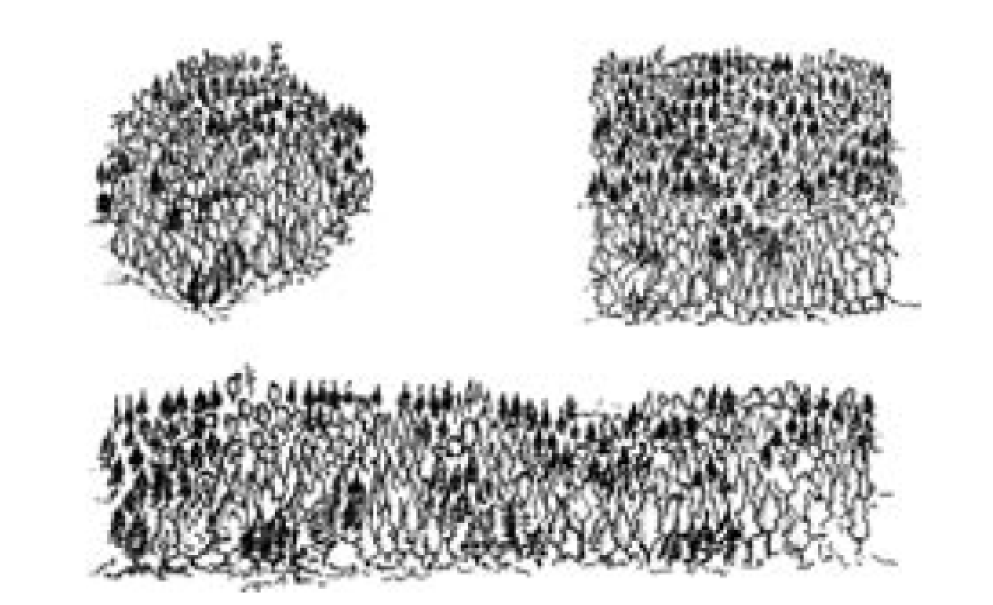
3) Forest Edges
The edges of forests can be dangerous places for birds that thrive in forest-interior habitat. This is because dangerous predators can be found on forest edges.
These predators can prey on bird nests making it difficult for birds to reproduce.
In general, Thrush species thrive in forests with less edge territory.
Forest in circle shapes have less edges and, therefore, provide a superior habitat for thrush species. Square or rectangular shaped forest have more edge territory.
ElbowLakeCentre.ca © Queen’s University Biological Station (QUBS), 2023

Slide 15
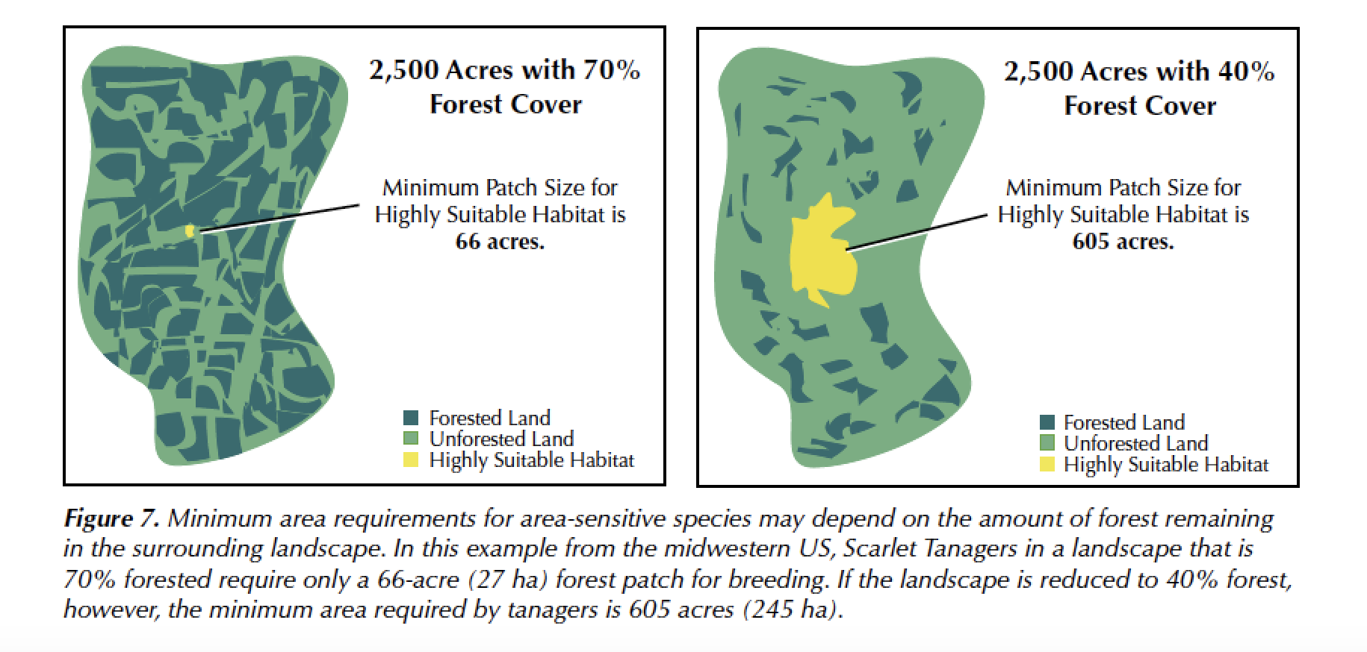
4) Amount of Forest in Surrounding Regions
The amount of forested area in the landscape surrounding a forest patch will also determine how successful thrush species are.
In general, as the amount of forest in a surrounding landscape increases, the minimum required forest patch size for many bird species decreases.
ElbowLakeCentre.ca © Queen’s University Biological Station (QUBS), 2023

Slide 16
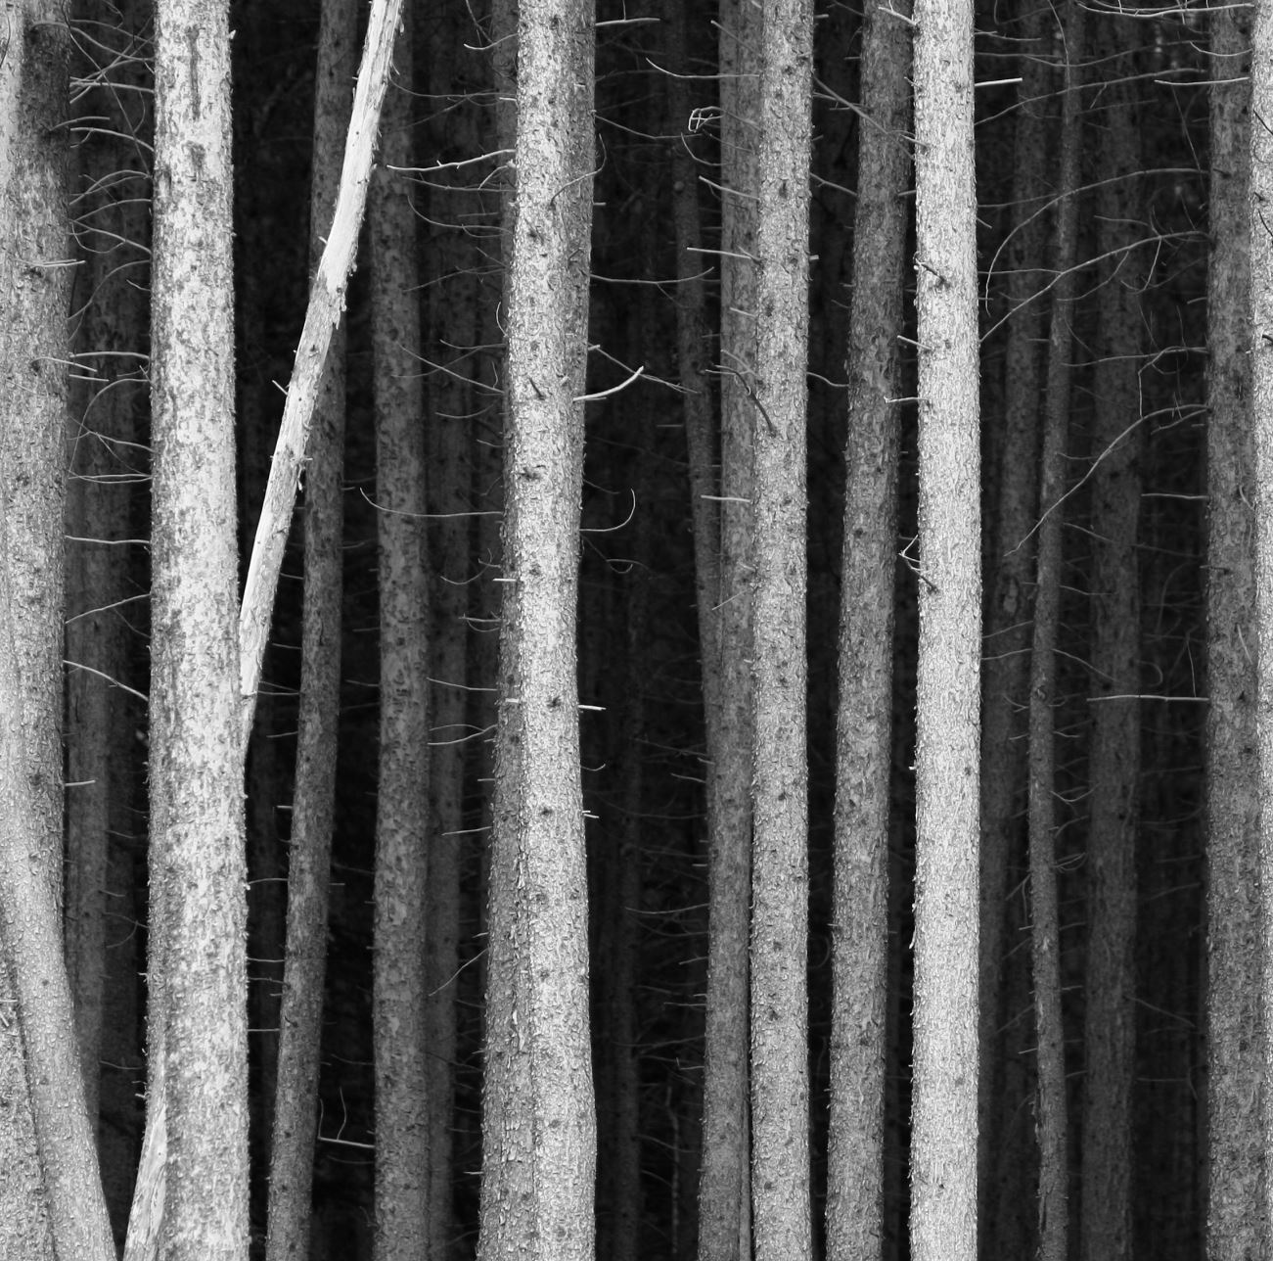
5) Forest Structure
Forest structure and age also determine a forest habitat’s suitability for bird species. A healthy aging forest has a diverse vegetation structure with vertical layering. This means that there are at least two layers in the forest. An understory of smaller shrubs and young trees and an overstory of branches created by mature trees. It is possible to have several layers in a forest.
Thursh species, like many other birds, depend on cover, food, and nest sites found in the understory.
ElbowLakeCentre.ca © Queen’s University Biological Station (QUBS), 2023

Slide 17
Challenge
ElbowLakeCentre.ca © Queen’s University Biological Station (QUBS), 2023

Slide 18
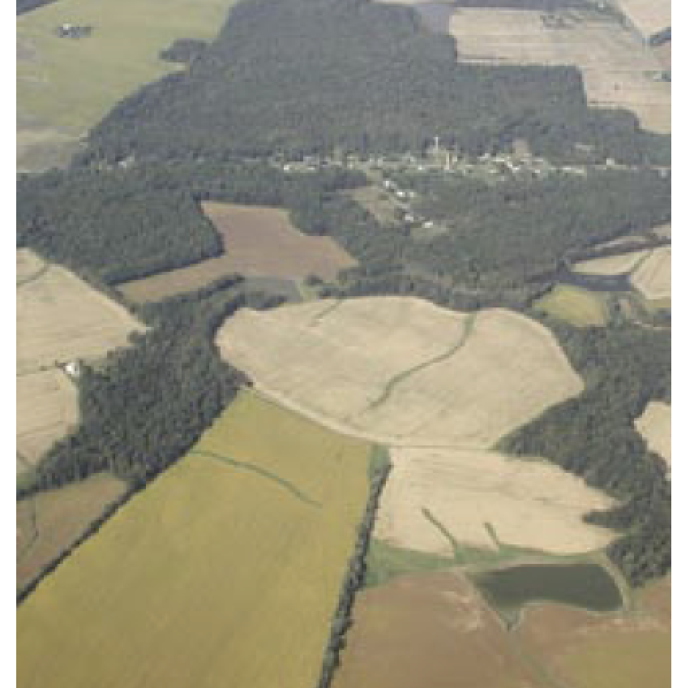
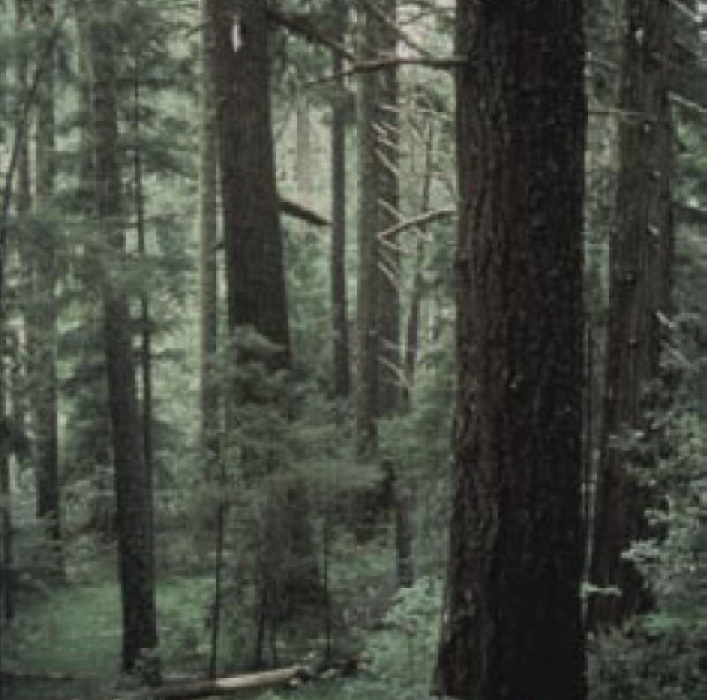
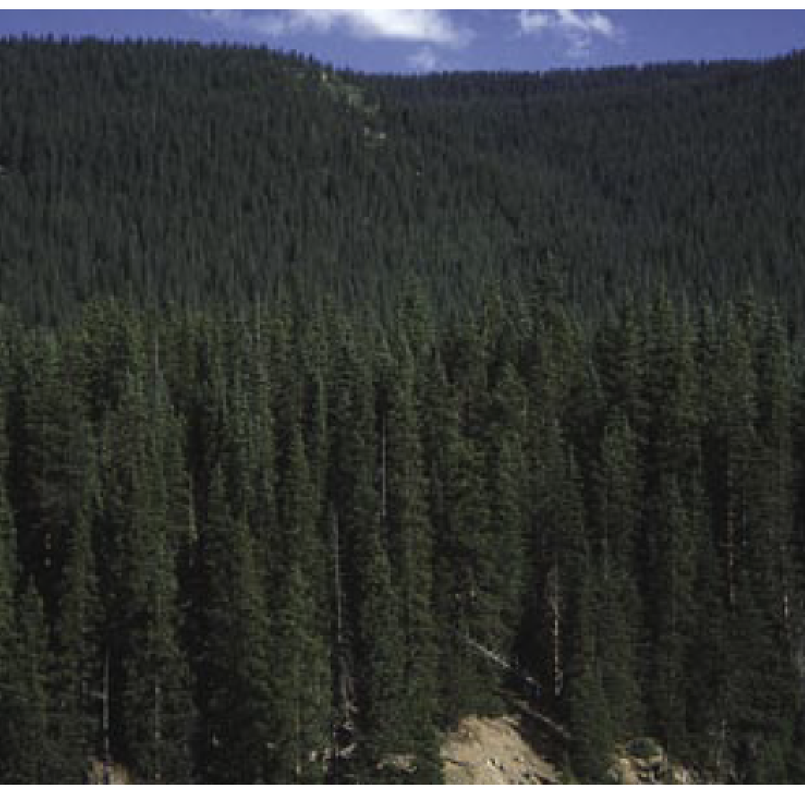
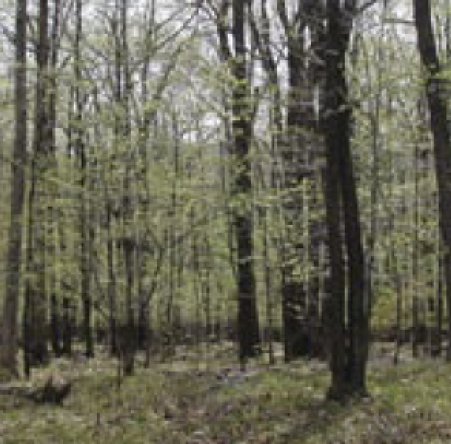
Examine the photos. Select and explain which habitat would enable Thrush species to thrive.
A
B
C
D
ElbowLakeCentre.ca © Queen’s University Biological Station (QUBS), 2023

Slide 19
Activity
Students can revisit the images in the PPT accompanying Activity 4.3 depicting land development in the Kingston and Ottawa region.
Students make predictions regarding how these changes have impacted local thrush species. Discuss what this means for biodiversity in the face of future development.
As a follow up activity students can research the Eastern Ontario Model Forest Program to learn more about what is being done locally to protect local forests from fragmentation and other threats. https://www.eomf.on.ca
ElbowLakeCentre.ca © Queen’s University Biological Station (QUBS), 2023

