Slide 1
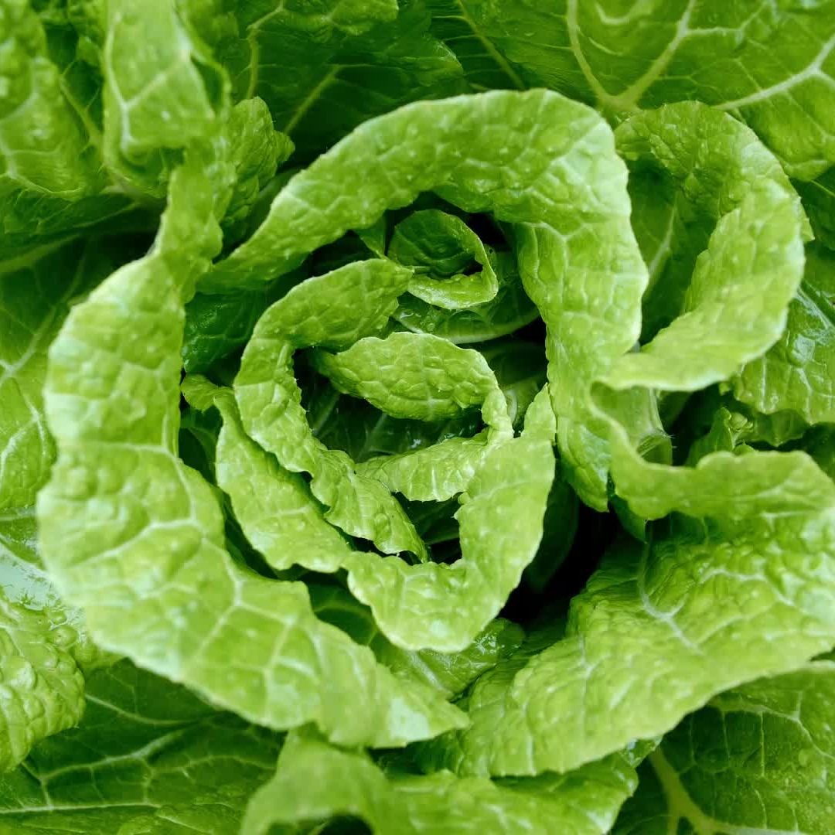
Invasive Species
ElbowLakeCentre.ca © Queen’s University Biological Station (QUBS), 2023

Slide 2
What is an Invasive Species?
Animals or plants from another location
Often transferred by boats or humans
Cause harm to the natural ecosystem of their new environment
Capable of causing extinctions of native plants and animals, destroy biodiversity, and permanently alter habitats
ElbowLakeCentre.ca © Queen’s University Biological Station (QUBS), 2023

Slide 3
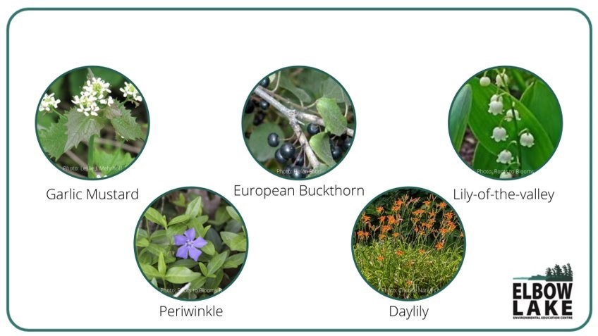
Examples of Invasive Species
Do any of these invasive species look familiar? Keep an eye out for them!
ElbowLakeCentre.ca © Queen’s University Biological Station (QUBS), 2023

Slide 4
Garlic Mustard
Spreads very fast and is considered one of Ontario’s most damaging forest plant species.
Was brought to Ontario from Europe because it is rich in vitamins A and C.
The biggest problem with garlic mustard is that it puts harmful chemicals into the soil that makes it impossible for any other plants to live there.
The roots release chemicals that interfere with native plants' ability to absorb nutrients.
ElbowLakeCentre.ca © Queen’s University Biological Station (QUBS), 2023

Slide 5
Global Garlic Mustard Field Study (GGMFS) What is it?
A study where scientists studied and recorded data on:
Estimated population size
Density
Age structure
Plant size
Reproductive success
Damage by herbivores and pathogens
Goals of experiment:
1. Learn more about what makes garlic mustard a good invader
2. encourage studies of other invasive species
ElbowLakeCentre.ca © Queen’s University Biological Station (QUBS), 2023

Slide 6
Global Garlic Mustard Field Study (GGMFS) How was the Study Conducted?
Completed over 4 years
164 scientists participated
Scientists were studying garlic mustard in Europe and North America
Each scientist followed this procedure:
Found a section of garlic mustard with dimensions of 1m x 0.5m.
Collected data about the number of plants, height of plants, number of flowers, number of leaves, number of damaged/undamaged leaves.
Took photos of the plants.
Collected seeds from 20 adult plants.
ElbowLakeCentre.ca © Queen’s University Biological Station (QUBS), 2023

Slide 7
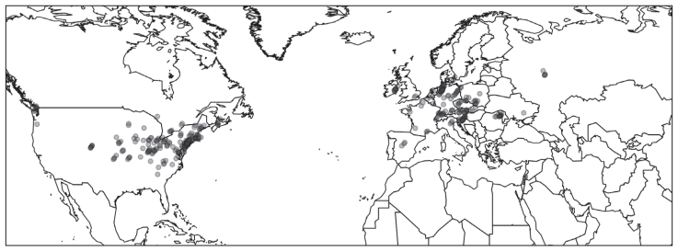
Where the Study was Conducted
ElbowLakeCentre.ca © Queen’s University Biological Station (QUBS), 2023

Slide 8
Global Garlic Mustard Field Study (GGMFS) Outcomes
Full data has not yet been released … stay tuned for the results!
Connected scientists from around the world.
Planning of studies for other invasive species is underway.
ElbowLakeCentre.ca © Queen’s University Biological Station (QUBS), 2023

Slide 9
Extension Activity – Part 1
Look for an invasive species on your schoolyard
Answer these questions:
Where is the invasive species from?
How did it get here?
Are there any benefits to the invasive species?
What impact does the invasive species do to the environment?
ElbowLakeCentre.ca © Queen’s University Biological Station (QUBS), 2023

Slide 10
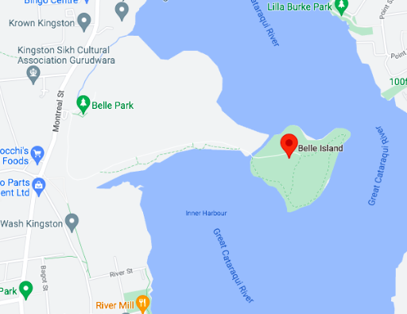
Extension Activity – Part 2
The study is now presented through a website, where you can all contribute to the data!
Step 1
Visit Garlicmustard.org
Step 2
Read through the “Identification Tips” on the website, and download the ”Seek” by iNaturalist App on your phone.
Step 3
Visit the local Belle Island and record your Garlic Mustard findings on the website under “Data Entry & Sightings Report”.
ElbowLakeCentre.ca © Queen’s University Biological Station (QUBS), 2023

